Slide 1
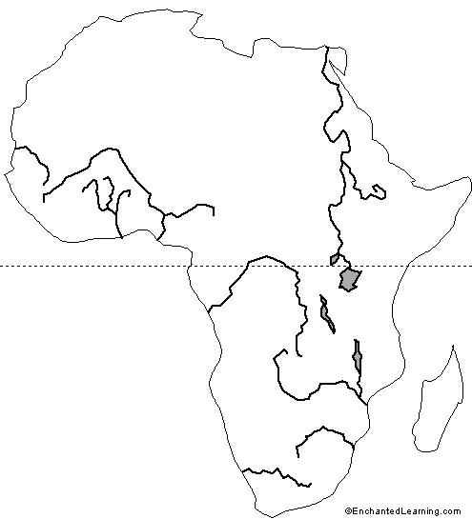
Songhay empire ruled the central Niger Valley in the 1400s and 1500s, controlling important trade cities such as Timbuktu and Jenne. Exported gold and slaves along the trans-Saharan trade routes, imported salt, textiles, and metal goods. Elite influenced by Islam, though traditional religious practices remained strong. After Moroccan invaders with firearms invaded Songhay, the empire broke into several smaller regional trading states.
Early Modern Africa
Berbers
Ottoman Empire
Christian Ethiopia
Hausa States
El Mina was one of many European “factories” or forts. It was established by the Portuguese with the consent of local rulers and was essentially a fortified trading post for Portuguese merchants and traders
.
Fulani
El Mina
.
Many Swahili Coast trading states such as Kilwa were subdued by Portuguese firepower in the 1500’s. Portuguese forces built administrative centers at Mozambique and Malindi and constructed forts throughout the region.
Malindi
.
The Asante built a powerful regional kingdom in the 1600s and 1700s. The Asante traded slaves and forest products such as ivory and palm oil to European in return for manufactured goods, especially guns.
Kilwa
The Kingdom of Kongo emerged as a strong centralized state in the 1300’s, and began trading with the Portuguese in the late 1400s. Elites converted to Christianity due to contacts with Portuguese merchants and missionaries. The Portuguese slave trade eventually strained relations, and as ties weakened the Portuguese founded the colony of Angola to the south of Kongo to continue their economic activities.
The Dutch began to settle the Cape in the 1600’s. Cape Colony became an important trade post and significant numbers of Dutch, French, and eventually British would settle on the Cape. Local Khoisan people were subjugated and enslaved. Many died from epidemic diseases to which they had no immunity.
.
Cape Town

Slide 2
Other important notes about early modern Africa:
About 11-12 million people traded in the Atlantic slave trade (more men for plantation labor.)
About 1.2 million people traded in the East African slave trade (more women for domestic labor.)
About 1.25 million people traded in the trans-Saharan slave trade (into both Mediterranean and Ottoman markets, for both domestic and agricultural labor.)
Both Christianity and Islam continued to spread in early modern Africa due to increased contact and trade.

Slide 3
