Slide 1
Think like a historian!
Analyze the following pieces of art from around the world, early modern era (c. 1450 - c. 1750). What evidence can we gather about this period of world history from these examples of art and architecture?
What changes – and continuities – might these works of art reveal?

Slide 2
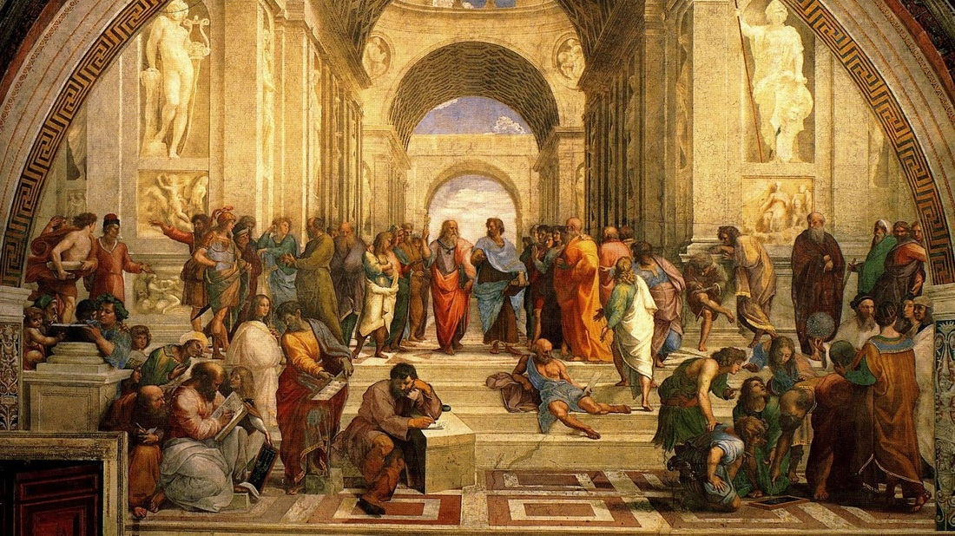
“School of Athens”
Raphael, early 1500’s

Slide 3
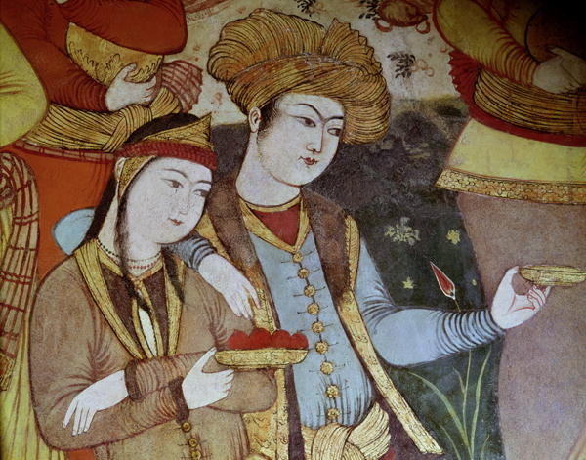
“Nobles at the Court of Shah Abbas I”
Art from the Persian Safavid Empire, 1600’s

Slide 4
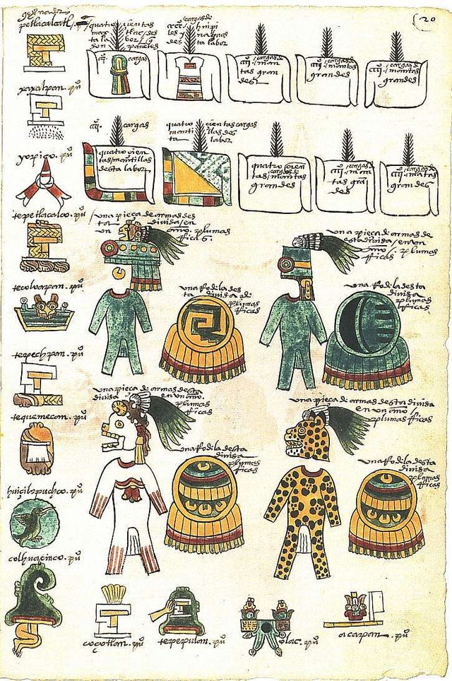
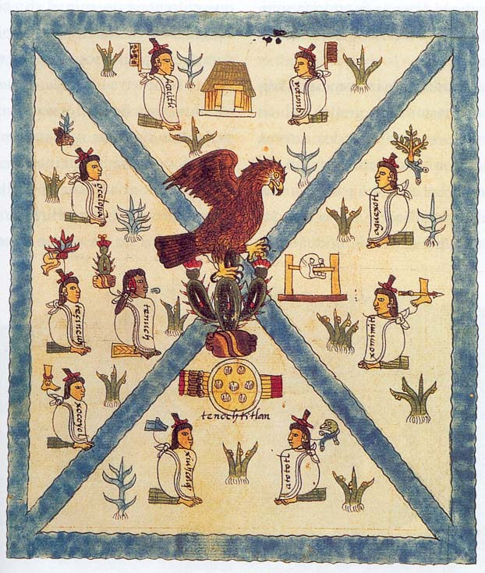
The Codex Mendoza is an Aztec codex, created about twenty years after the Spanish conquest of Mexico with the intent that it be seen by Charles V who was the Holy Roman Emperor and also the King of Spain. It contains a history of the Aztec rulers and their conquests, a list of the tribute paid by the conquered, and a description of daily Aztec life. It is written with traditional Aztec pictograms and also has explanations written in Spanish.
Page one of the Codex Mendoza
A page from Section II of the Codex Mendoza, which provides a list of the towns conquered by the Triple Alliance and the tributes paid by each.

Slide 5
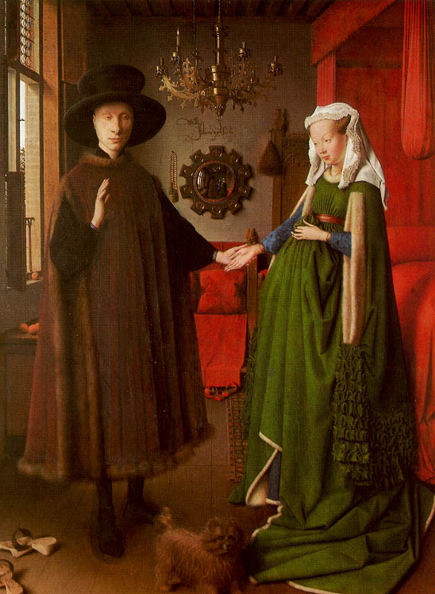
“Giovanni Arnolfini and His Bride”
Painted in the 1400’s by the Flemish Renaissance Master Jan Van Eyck

Slide 6
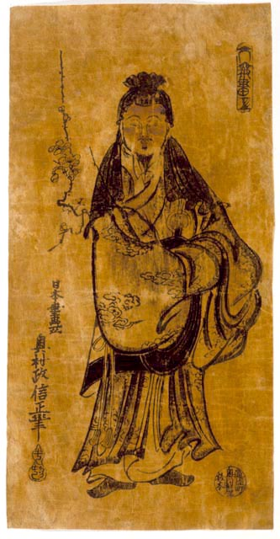
Japanese Woodblock Printing
In the style known as Ukiyo-e, or “pictures of the floating world”
This print by Okumura Masanobu (ca. 1686-1764) depicts a nobleman, Sugawara Michizane (845-903), who, according to Japanese legend, became the god Kitano Tenjin. In a deified form, his spirit is said to have flown to China to learn Zen, paying for his lessons with a sprig of flowering plum. Such portraits of Michizane--who became the patron deity of scholarship and learning--developed among fourteenth- and fifteenth-century Japanese ink painters and shrines were built throughout Japan in his honor.

Slide 7
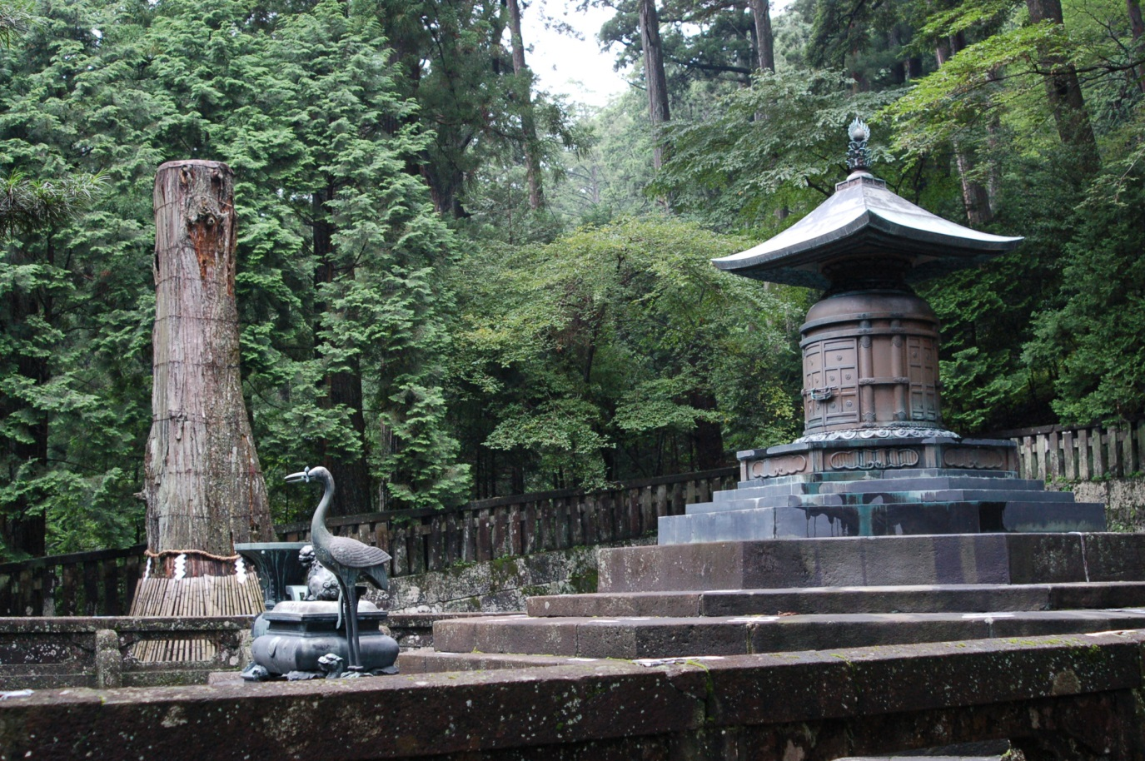
Japanese Shogun Tokugawa Ieyasu’s Mausoleum

Slide 8
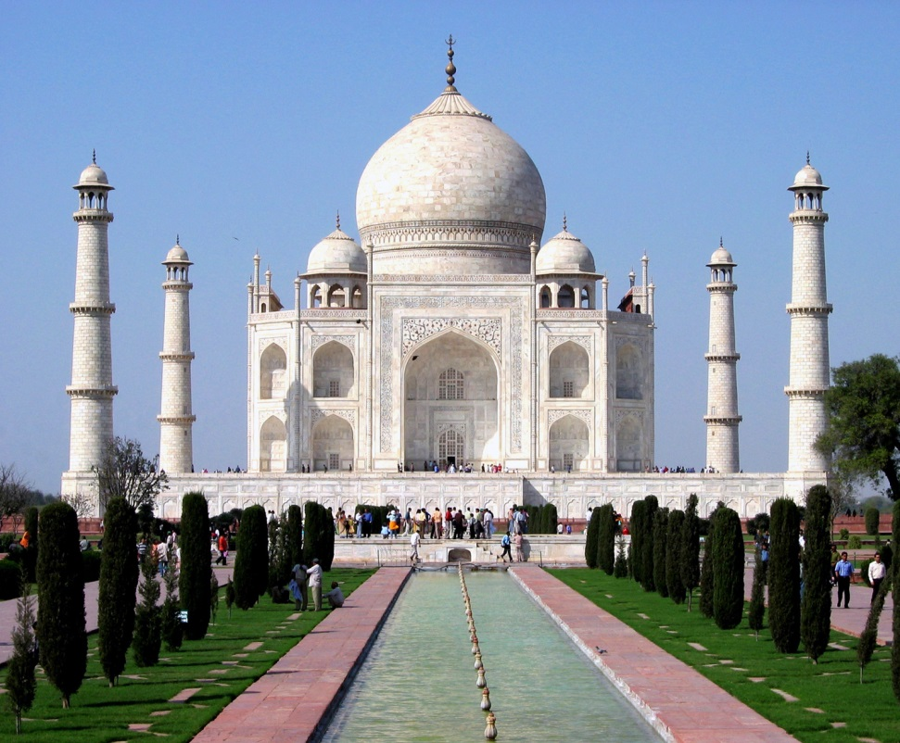

Slide 9
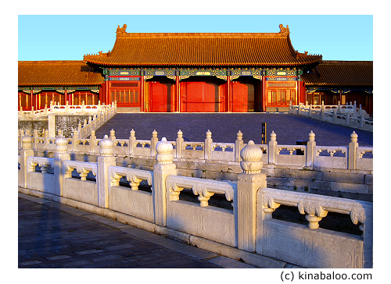
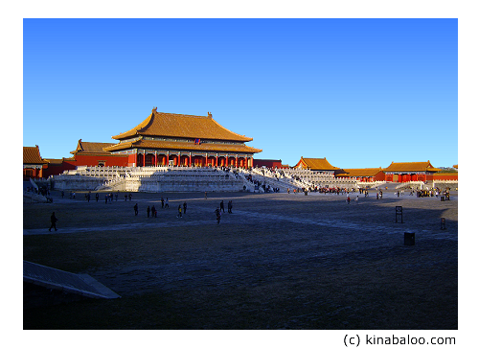
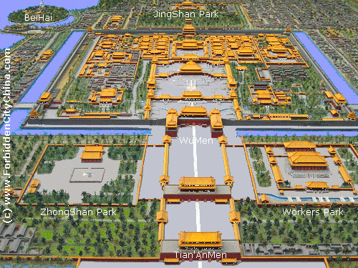
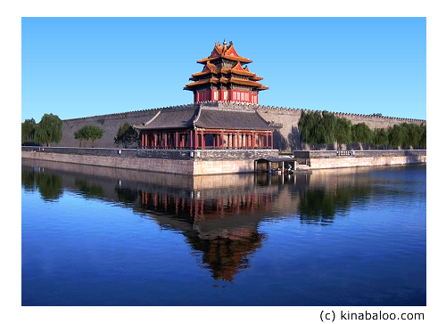
The Forbidden City in Beijing, built in the 1400’s by the Ming Emperor Yongle

Slide 10
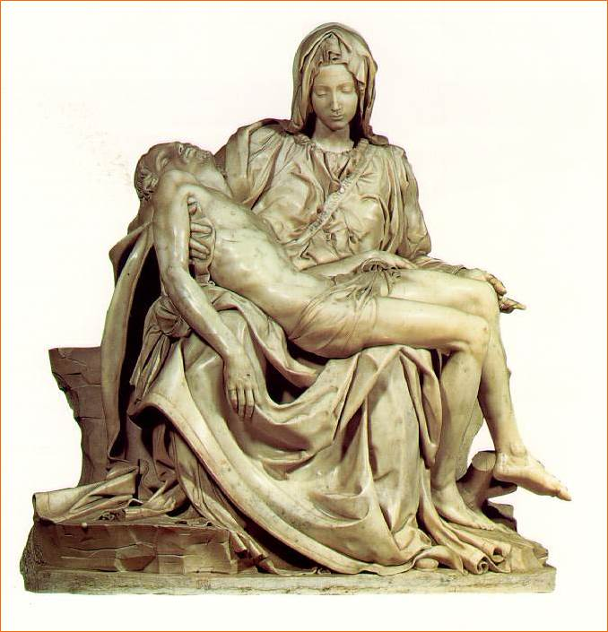
Michelangelo
“La Pieta”

