Slide 1
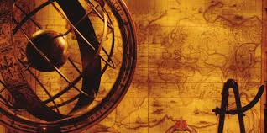
Introduction to
AP World History
2017-2018

Slide 2
What is your definition of history?
Padlet Link

Slide 3
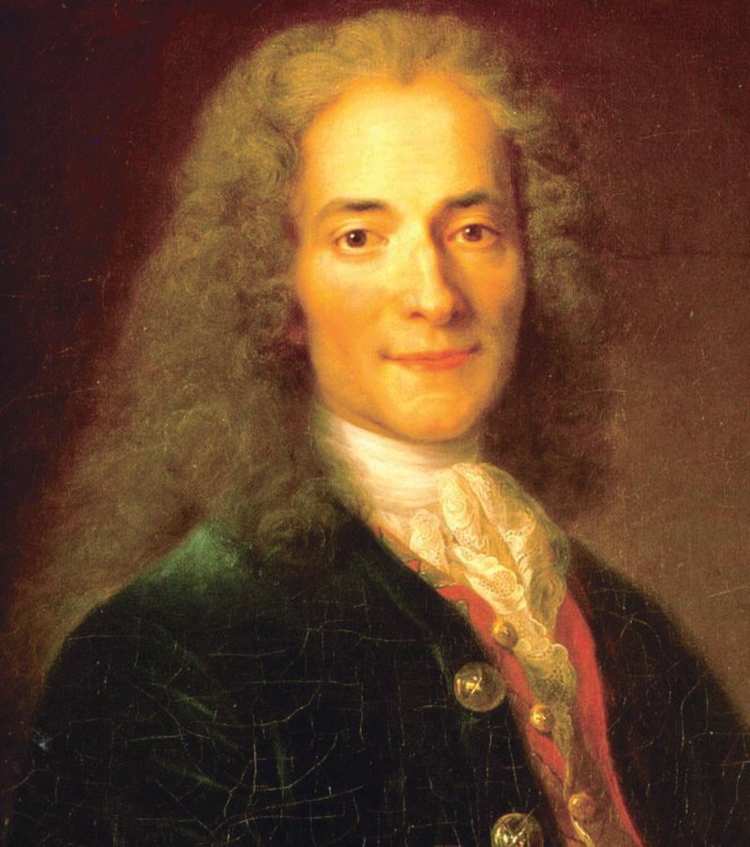
History is the lie commonly agreed upon.
Voltaire, 18th century
French writer, philosopher, and Enlightenment thinker

Slide 4
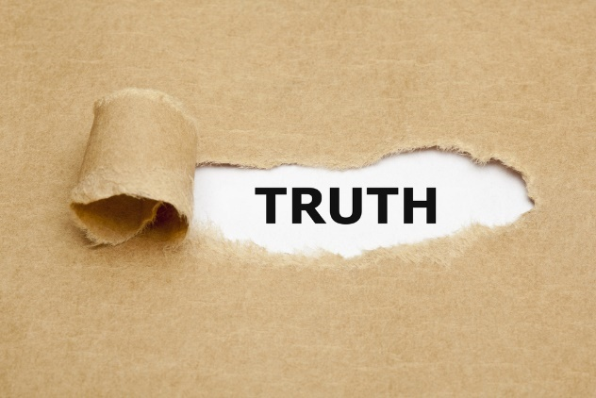
So how do we know the “truth” when studying history?
Beware of the half truth. You may have gotten hold of the wrong half.
-Unknown Source

Slide 5
Using AP History Disciplinary Practices and Historical Reasoning Skills
As students of history, the best we can do is study history analytically and critically - - we will do this by developing our historical reasoning skills and practices:
Analyzing evidence and developing historical arguments – we will analyze both the historical content and the sourcing of primary and secondary documents, then use the results of our analyses to develop sound arguments. In addition, we will analyze and evaluate the different ways historians interpret the past (an important component of historiography.)

Slide 6
Using Historical Reasoning Skills
Contextualization – we will work on connecting historical events to broader contexts of time and place (and vice versa.)
Comparison – we will identify and analyze similarities and differences among societies, historical processes, and historical events and patterns.

Slide 7
Using Historical Thinking Skills
Causation – we will identify and analyze historical causes and effects
5. Change and Continuity over Time - we will trace and explain historical changes as well as historical constants, or continuities over time.

Slide 8
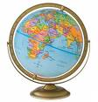
So what is history?
History is the study of the human past. Based on careful analysis of surviving texts (primary and secondary sources) and artifacts (objects made by humans,) historians attempt to reconstruct the past events and processes which have created our current world.

Slide 9
So what is history?
Historiography:
The study of the principles, theory, and history of historical writing and record keeping.
http://qcpages.qc.cuny.edu/writing/history/critical/historiography.html

Slide 10
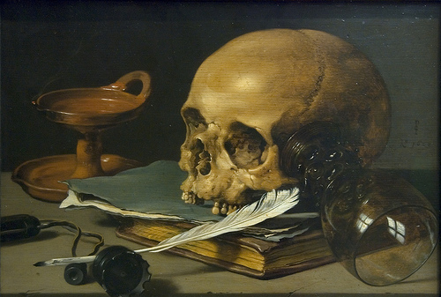
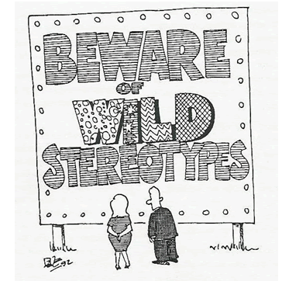
So what is history?
Historians, through careful analysis, attempt to reconstruct the past.
But always remember that every historian (and every student of history) views the world through a cultural lens.

Slide 11
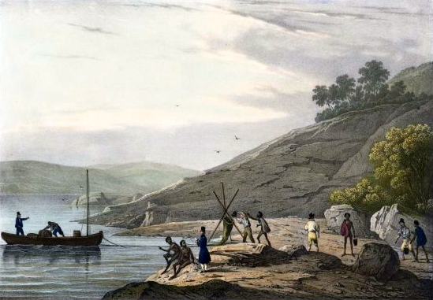
What about World History?
By studying civilizations and societies, particularly paying attention to cases where societies have come into contact with others, world historians focus on the world as a whole and how diverse societies fit into that whole.
Crew of the French ship L'Astrolabe make contact with aborigines at King George Sound,western Australia, 1826

Slide 12
World History
World Historians try to move beyond the narrow confines of one perspective.
Tim E. Ogline, Illustrator

Slide 13
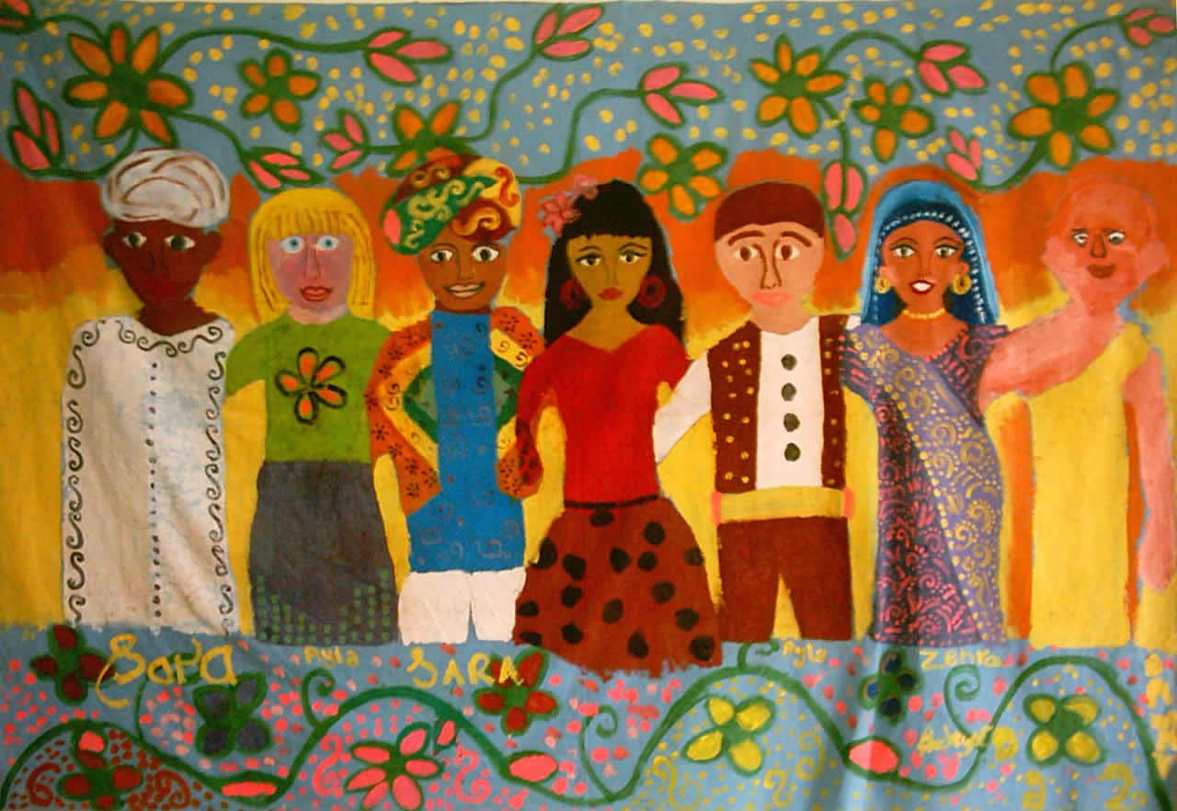
World History
Perhaps the study of World History can help individuals view and understand the world from a less culture-centric point of view; and with a broader, more well-rounded understanding of the world.

Slide 14
AP World History
So how are we, as a class, going to approach the daunting and challenging task of studying 12,000+ years of human history in one school year?

Slide 15
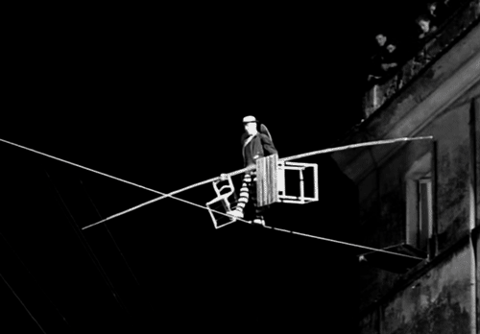
AP World History
How does a student remain calm and
balanced in the midst of so much content?

Slide 16
AP World History
First, keep in mind that the historical reasoning skills we will develop together are even more important than the content you will learn – and we will work on developing these skills throughout the year!
Second, remember that I am here to help. If you are willing to work hard, I will do everything possible to support and help you. ☺

Slide 17
AP World History
To make the course content more manageable, it is divided into Six Periods of World History.

Slide 18
AP World History
Periodization of AP World History
Periodization is the process of identifying and organizing the past into blocks of time, or eras, to facilitate the study of history. There are many different ways to organize and study history. For example, Chinese history is usually divided based on ruling dynasties.

Slide 19
AP World History
In the academic discipline of world history, periodization is generally guided by global shifts and themes. Here are some principles that shape the periodization of world history:
Widespread geographic shifts and changes (in other words, the world map changes significantly – could be cultural, political, economic, and/or environmental changes)
Changes in contacts and connections among groups or societies
The emergence of parallel developments across the globe

Slide 20
AP World History
In our class, the units of study are based on these six world historical periods.

Slide 21
AP World History
A few important notes about periodization and dates in AP World history:
Remember, all systems of periodization are arbitrary, and labels/dates assigned to time periods are continually challenged and redefined.
World historians use BCE and CE rather than BC and AD in historical dating. This is because world history studies focus on viewing and understanding the past from a global perspective.

Slide 22
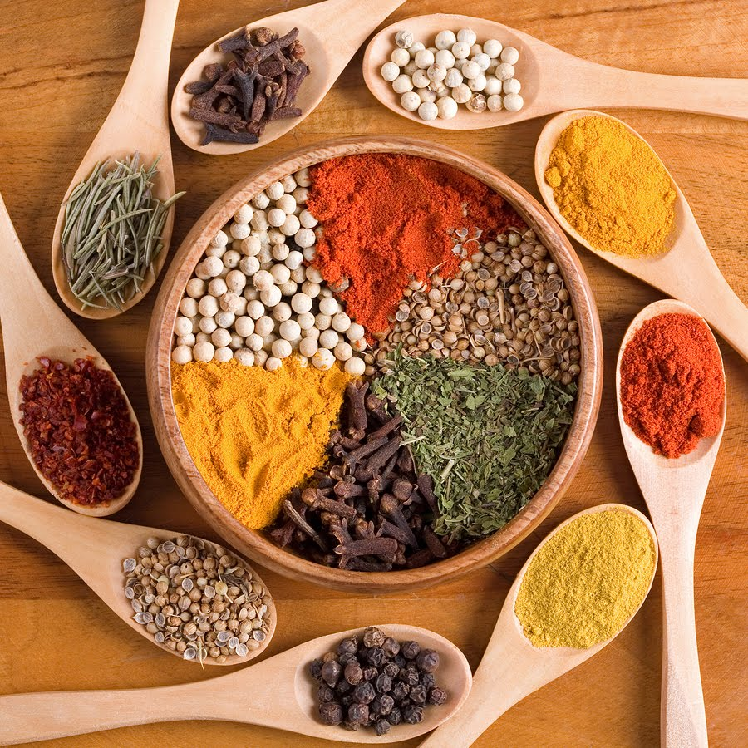
AP World History Themes
Our course is also divided by five themes to help us manage and organize the large amount of content.
S.P.I.C.E.

Slide 23
S
AP World History Themes - Social
Development and transformation of social structures
Gender roles and relations
Family and kinship
Racial and ethnic constructions
Social and economic classes

Slide 24
P
AP World History Themes - Political
Political: state-building, expansion, and conflict
Political structures and forms of governance
Empires
Nations and nationalism
Revolts and revolutions
Regional, trans-regional, and global structures and organizations

Slide 25
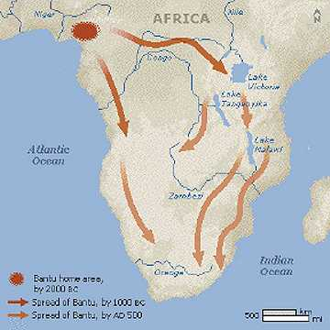
AP World History Themes– Interactions between humans and the environment
I
Interaction between humans and the environment
Demography and disease
Migration
Patterns of settlement
Technology

Slide 26
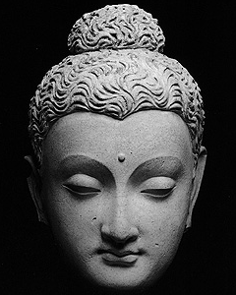
C
AP World History Themes - Cultural
Development and interaction of cultures
Religions
Belief systems, philosophies, and ideologies
Science and technology
The arts and architecture

Slide 27
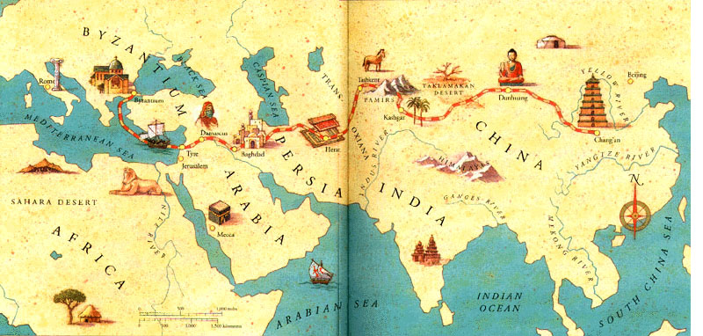
E
AP World History Themes - Economic
Creation, expansion, and interaction of economic systems
Agricultural and pastoral production
Trade and commerce
Labor systems
Industrialization

Slide 28
And finally the last word…
Always keep in mind what the study of world history is really all about:
Our world, our history, and our human stories are interconnected.
Current events have historical roots.
To understand the present, the past must be examined.

Slide 29
And so our journey begins!

