Slide 1
Migrations:
Why, Where, and the Impact of the Movement of Peoples

Slide 2
Reasons for Migration
Push Factors
  Negative conditions at home
    Real conditions
    Perceived conditions
  Impel the decision to migrate
Pull Factors
  Positive attributes in destination
    Real opportunities
    Perceived opportunities
  Pull the immigrant to move

Slide 3
Push Factors
Not enough jobs
Few opportunities
"Primitive" conditions
Political fear
Not being able to practice religion
Poor medical care
Loss of wealth
Natural disasters
Death threats
Slavery
Pollution
Poor housing
Landlords
Poor chances of finding courtship
War conditions in area
Pull Factors
Job opportunities
Better living conditions
Political and/or religious freedom
Enjoyment
Education
Better medical care
Security
Family links
Better chances of finding courtship
Get rich easily

Slide 4
Types of Migration
Home Community
    Movement from one place to another within their community
    Most common form of migration
    Distance measure in yards and miles
    Associated with youth leaving home, jobs, marriage
    Examples include matri- and patrilocal, as well as modern USA
Colonization
    People leaves older community to establish a new one in another place
    Desire is to create an exact replica of an existing culture elsewhere
    Greek, Phoenician, Early Modern European colonization are examples
Whole-Community or Mass Migration
    An entire community migrates to a new land
    Often migration in response to environmental conditions
    Nomadic migration including seasonal migration for flocks
    Can also include mass migration to avoid war or forced migration
    Generally a low level of community development
    Examples include the Germanic Migration, Irish Diaspora
Cross-Community
    Involves groups/individuals migrating to live within another community
    Such communities settle amongst others but do not assimilate
    Examples include migrant workers, students in foreign universities
    Picks up ideas, technology, skills spreading them back to mother country
    Often considered free migration to seek temporary job, education
    Examples include Jewish, Nestorian and Chinese immigration

Slide 5
Limitations on Migration
Political restrictions
  Many countries have restrictions
  Some have entry quotas
  Some have exit requirements
Geographical restrictions
  Distance and transport
  Physical barriers to movement
Opportunities of Costs
  What do I gain, what do I lose
Personal characteristics

Slide 6
Pre-Historic Migration
Out of Africa: The Peopling of the World
c. 2 million BCE
To 15,000 BCE

Slide 7
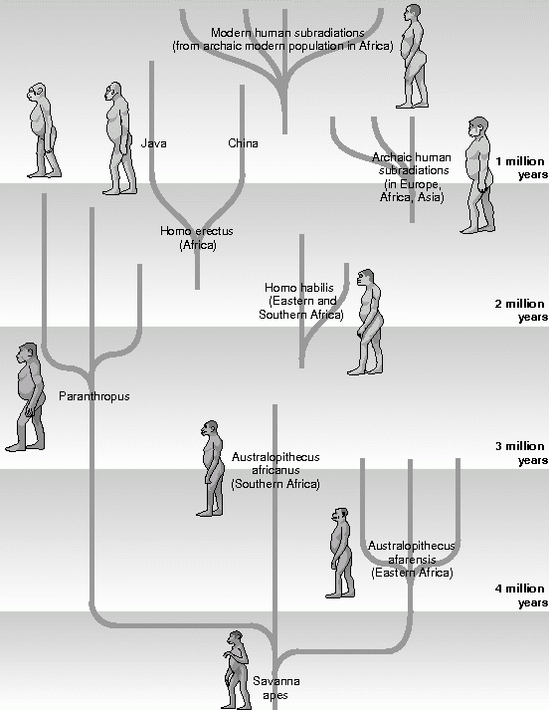
Humans Spread
Across Globe
Hominids
  Arose in Africa 1-2 million years ago
  Migrated throughout Eurasia
Homo-Sapiens
  As a species arose c. 300,000 years ago
  Arose in East Africa, The Horn of Africa
Hunter-Gatherer Society
  Nomads followed game, gathered seeds
  Conduits across Strait of Gibraltar, Sinai
  Southwest Asia reached c. 70,000 BCE
  East Asia reached c. 60,000 BCE
  Australia reached c. 50,000 BCE
  Europe reached c. 40,000 BCE
  North America reached c. 20,000 BCE
  South America reached c. 15,000 to c. 12,000 BCE
  All Pacific Islands not reached until c. 1000 CE
Proof
  We use DNA, genetic drift, chromosomes, archaeology as proof
  We look at languages and linguistics

Slide 8
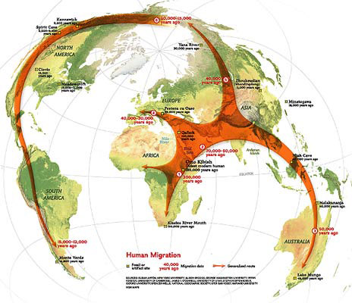
Out of Africa Migration

Slide 9
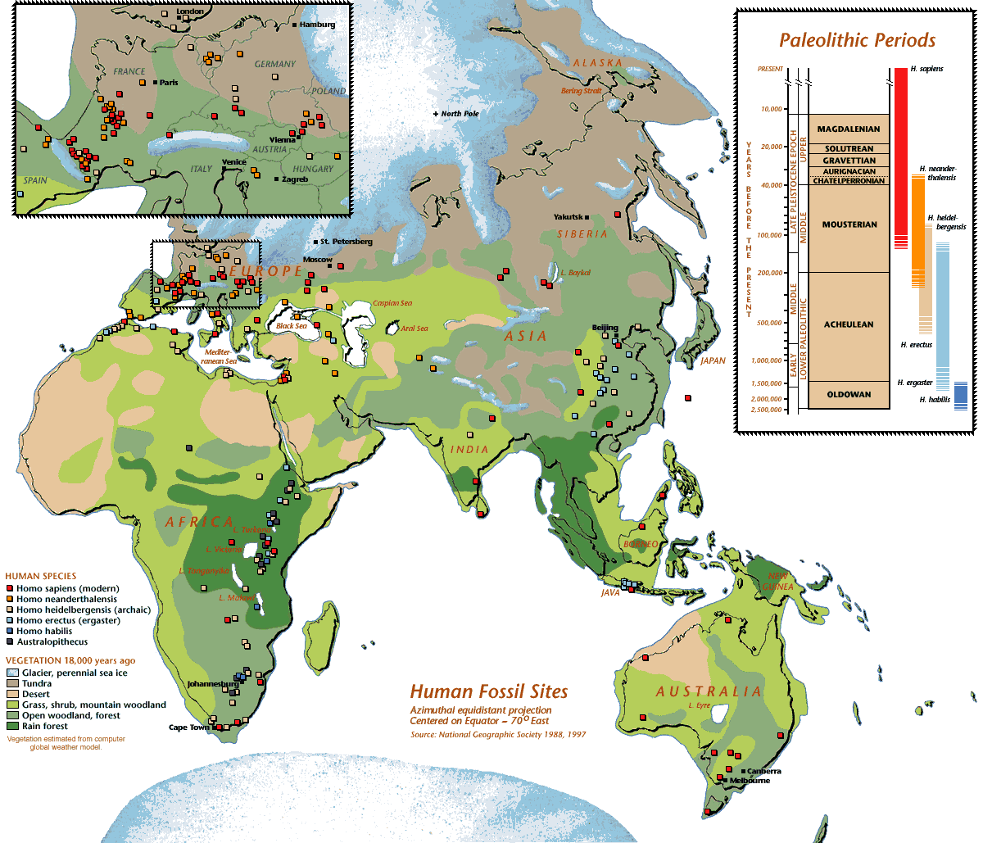
Human Fossil Record

Slide 10
“The Government Would Like You To Move to This New Place”
Historical Colonial Movements of Peoples

Slide 11
What is colonization?
Definition
  Extension of sovereign control over neighboring territory
    Colonialism: The physical settlement of your people abroad
    Neo-Imperialism: Control land to exploit resources but no (or very little) settlement
  National populations resettled onto conquered lands
  Indigenous populations displaced, assimilated, eliminated
  Local labor resources controlled, markets exploited
  New socio-economic, linguistic, religious, culture introduced
Types
  Settler Colonies – Some Examples
    Phoencians, Greeks, and Romans
    Arabs, Turks, Mongols, and Ottomans
    Malayo-Polynesians
    Bantu and Berbers in Africa
    Chinese in Western lands, Germans in Eastern lands
    English in Ireland
  Dependencies
    Lands under control of a foreign state but not settled by its people

Slide 12
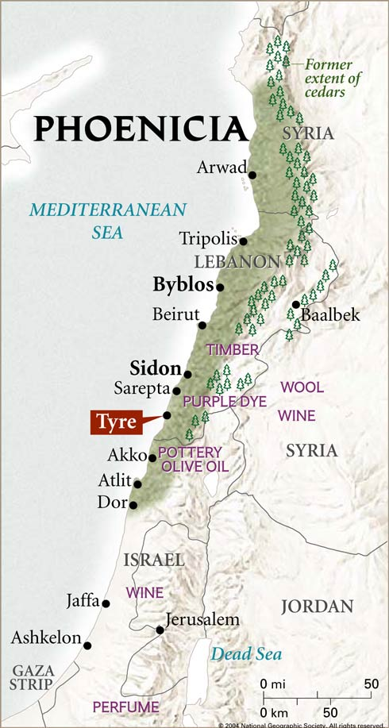
Phoenicians & Carthaginians
Original Home of Phoenicians c. 1000 BCE
  Coast of Eastern Mediterranean near Lebanon
  Mountainous area with little arable soil
  Interior controlled by powerful states
  Cities arose on the coast oriented outward
Movement
  Trade began to obtain needed materials
    Sufficient trees provide materials to build boats
    Phoenicians became sailors and maritime experts
    Acquire raw materials and make finished goods for trade
    Famous for cloth, purple dye, metallurgy
  Overpopulation
    Excess population immigrates to establish new settlements
    Phoenicians settle Cyprus, southern coasts of Western Mediterranean
  Rivalry with Greeks for Mediterranean Sea, trade, settlement
Carthaginian Empire, c. 600 to 200 BCE
  Arose as original homeland fell under various empires
  Settles Western Sicily, Sardinia, Baleric Islands, Southern Spain
  Exploits rich crop lands for wine, olives
  Discovers rich silver vines, ships trade for tin with southern England
  Battled Etrsucans, Kelts, Greeks and Romans for Western Mediterranean
  Conquered by Rome

Slide 13
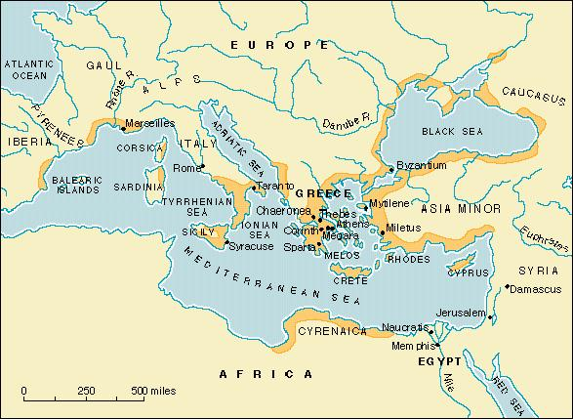
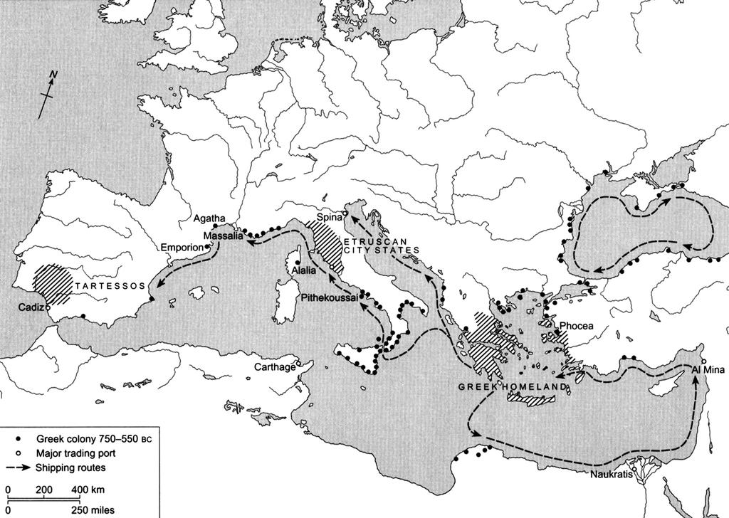
Greek World

Slide 14
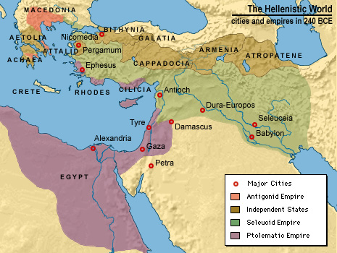
The
Hellenistic
World
Alexander’s World
  He founds Greek cities as his armies advance
  Greek administrators, soldiers, merchants migrate in wake
  Greek ruled states arose within his failed empire
Successor Hellenistic Monarchies
  Greek cities throughout their states
  Greek predominate language of area
  Greeks formed elite settler society

Slide 15
The Vandal Migration
The Volkerwanderung 400 CE
  Entered Roman territory
    Many embraced Christianity
    Few were Roman Catholics
    Most followed Arian Christianity
  Crossed into Gaul
    Battled the Franks, forced Vandals to move into Iberia
    Crossed into region as Roman feoderati
    Settled Galicia, Western, Southern areas
Into Africa
  Crossed Strait of Gibraltar to use it as a base
  439 CE conquered Carthage, made it capital
  Settled area around modern Tunis, Eastern Algeria
  Conquered Sardinia, Sicily, Corsica; sacked Rome 455
  Created a powerful state
Later State
  Suffered conflicts between Catholics, Arians
  Byzantines invaded, conquered area in 534

Slide 16
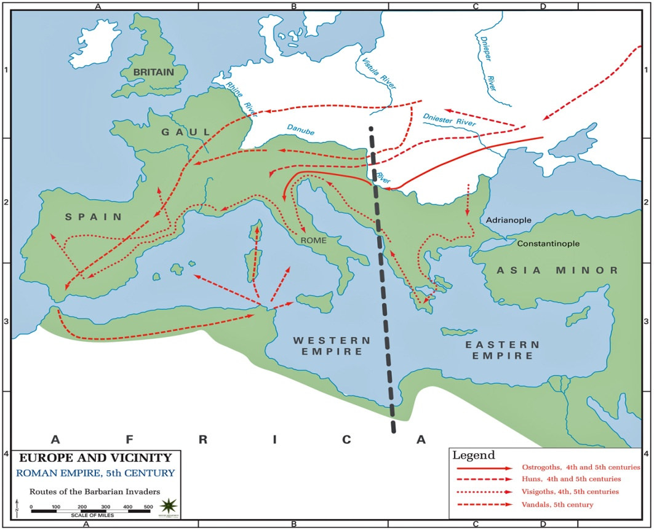
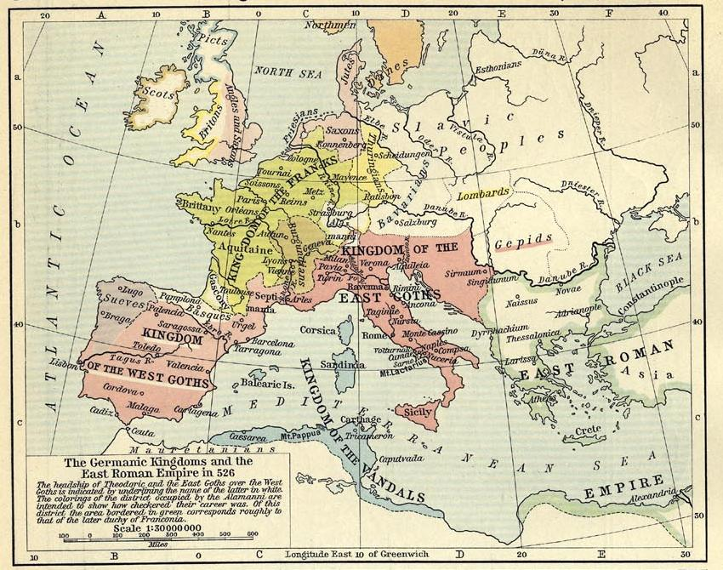
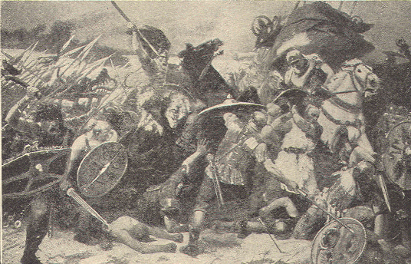
Mapping Vandal Movement

Slide 17
THE BANTU MIGRATIONS
Out of Nigeria, Movement in the South

Slide 18
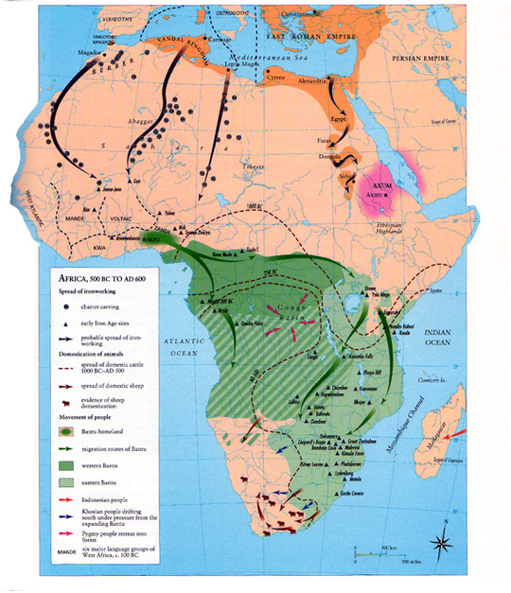
EARLY
MOVEMENT IN
AFRICA

Slide 19
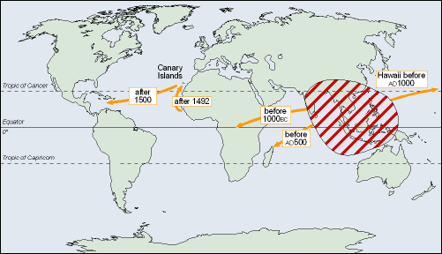

Movement
Spreads
Other Items
The Bantu Migration
  Population pressure led to migration, c. 2000 B.C.E.
    Movement to South, along Southeast and Southwest coasts
    Languages differentiated into about 500 distinct but related tongues
    Occupied most of sub-Saharan (except West) Africa by 1000 C.E.
    Split into groups as they migrated: Eastern, Central, Southern
  Bantu spread iron, herding technologies as they moved
Bananas
  Between 300/500 C.E., Malay seafarers reached Africa
    Settled in Madagascar, visited East African coast
    Brought with them pigs, taro, and banana cultivation
    Bananas became well-established in Africa by 500 C.E.
  Bantu learned to cultivate bananas from Malagasy
    Bananas caused second population spurt, migration surge
    Reached South Africa in 16th century CE

Slide 20
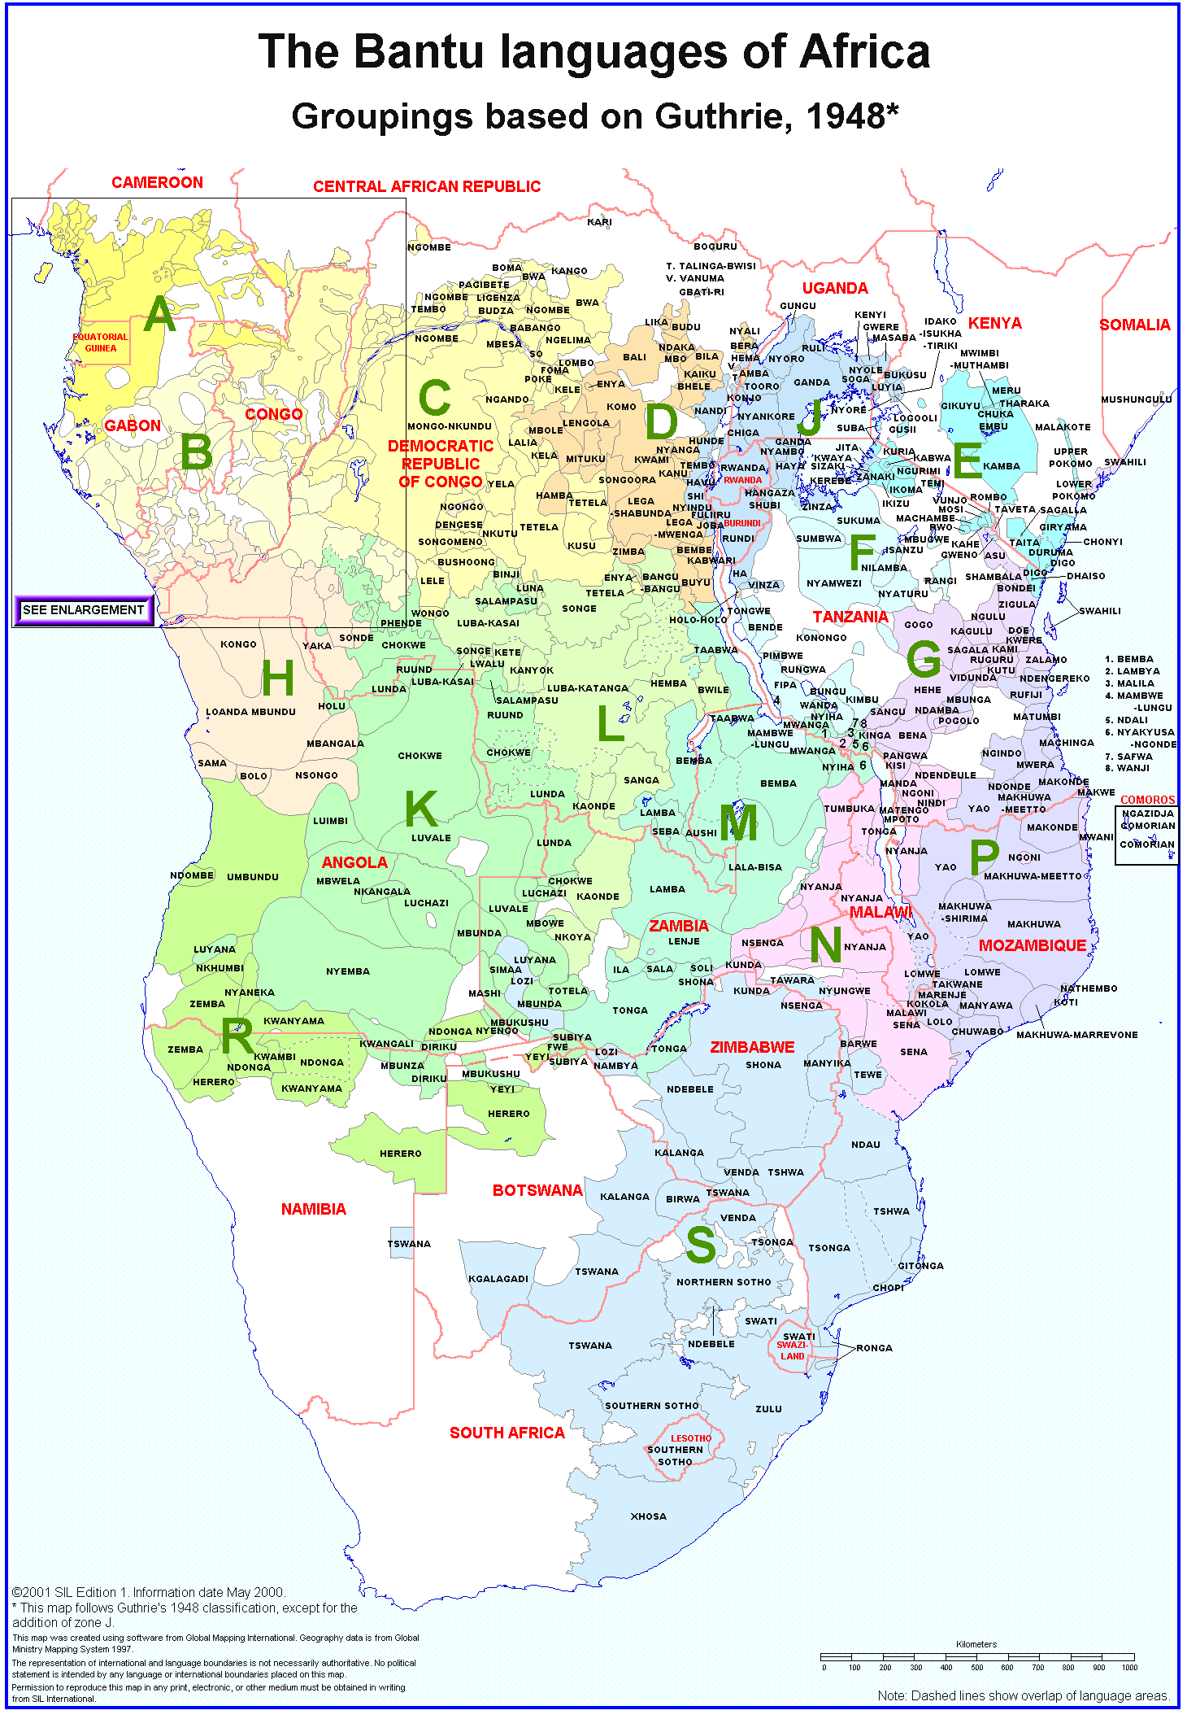
Using Language and Dialect to Trace Movement

Slide 21
Impact of Migration
Geographic Diversity Creates Social Diversity
  Extended families and clans as social and economic organizations
  A group of villages constituted a district but separated by distance
  Communities claimed rights to land, no private property
  Language, social differences arose based on geography
Movement Produces Interactions
  Exchange of ideas and goods especially flora, fauna, technology
  Exchange of DNA: rise of syncretic societies
  War and Trade between societies
Stateless societies
  Early Bantu societies did not depend on elaborate bureaucracy
  Societies governed through family and kinship groups
  Chief of a village was from the most prominent family heads
  Villages chiefs negotiated inter-village affairs
Chiefdoms
  Population growth strained resources, increased conflict
  Some communities began to organize military forces, 1000 C.E.
  Powerful chiefs overrode kinship networks and imposed authority
  Some chiefs conquered their neighbors

Slide 22
The Migration of
Semitic (Arab, Jewish) Peoples
640 – 1500 CE

Slide 23
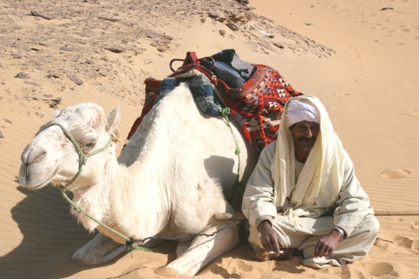
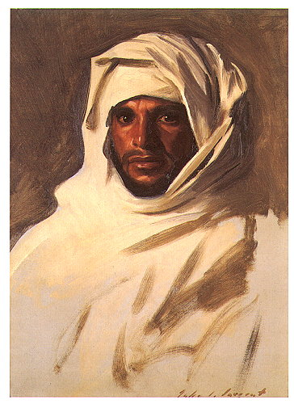
Early Migration
Primitive Migration
  Nomadic Pastoralism
    Move with flocks seeking grazing land, water
    Winter, Summer Pasture lands
    Re: Abraham in the Old Testament
  Movement between desert, first cities
    Often involving raid, trade
    Some intermarriage
  Constant clan warfare scattered tribes
Early Commerce
  Rise of sedentary settlements on oases
  Fertile areas with irrigation in Yemen
  Cities develop trading connections
    Gold, frankincense, myrrh, manufactured items
    Trade connects Western Arabia to Levant
Early Religious Movement
  Mecca develops as a site of polytheistic religious pilgrimage
  Jewish diaspora reached area: a Jewish tribe in Medina area
  Monophysite Christians moved to area to avoid persecution
Early Colonization
  Himyarites expanded towards Persian Gulf
  Sabeans who were probably Himyarites expanded into Horn of Africa
  Axum was clearly a Semitic civilization originally connected to Southern Arabia

Slide 24
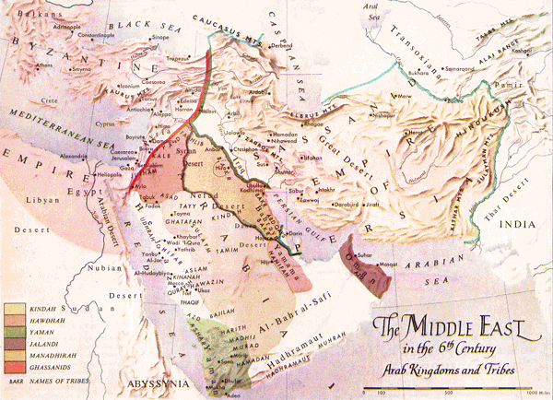
The Early Arab World

Slide 25
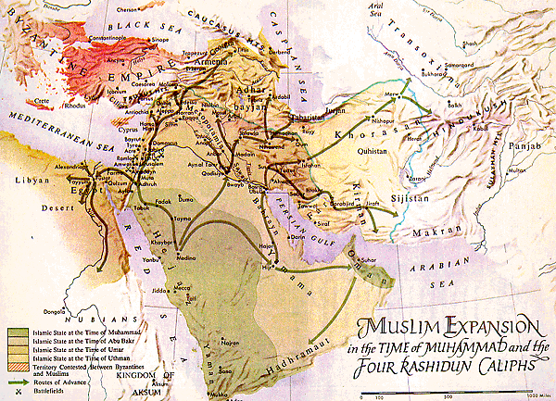
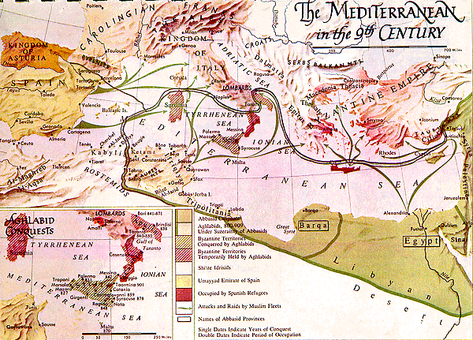
The Arab
Islamic
Empire

Slide 26
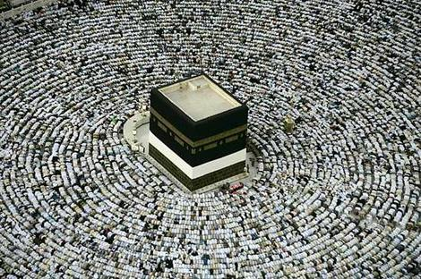
Later Migration
Military Conquest
  Whole tribes mobilized to conquer Arabia; pushed into Persia, Byzantines
  Arabs settled as garrison units on desert, arable land borders
  Whole garrison towns constructed to administer empire
  Whole tribes resettled to maintain military control
Muslim Pilgrimage
  One of the Five Pillars of Islam
    Originally was to be a pilgrimage to Jerusalem, replaced by Mecca
    All Muslims must try at least once in life to make journey to Mecca
  Shia-Sunni Split
    Shia developed holy sites of dead martyrs and saints
    Faithful made regular pilgrimages to venerate heroes
  The Hajji and the Gadis
    Learned Muslims often traveled between cities teaching, dispensing justice
    Itinerant preachers, wanders such as gadis (judges) and sufis (mystics)
Commerce and Intellectual Migration
  Arab Empire encouraged commerce, trade
    Empire becomes one long linked trade route of exchanges
    Arabs become trade diaspora at first but intermarry spreading Arab culture, language
  Arab Centers of Learning in Major Cities
    Islam encouraged intellectual pursuits, caliphs built schools and libraries
    Centers of Learning in Cordoba, Cairo, Damascus, Baghdad attracted travelers
  Bedouin Migration
    Overcrowding of Arabia, constant warfare led Arab Bedouin tribes (Banu) to migrate
    Sahara, Libyan and Central Asian deserts witness migrations

Slide 27
TRADE
DIASPORAS
Classical Through Contemporary Eras

Slide 28
What is a Trade Diaspora?
Defined
  Groups of merchants living amongst aliens in associated networks
    Result of international trade in high valued luxuries
    Merchants settle in certain countries to facilitate their trade
  Types
    Stayers: Permanently settled in foreign land to facilitate trade
    Movers: Those merchants who move between countries carrying goods
    Victim Diaspora: ethnic community violently uprooted which trades to link parts
Causes of Trade Diaspora
  Existence of competing states and political system with borders
    Often merchants alone could move between competing regimes
    Political systems protected trade diasporas as they supplied luxuries
  Culture of Commerce
    Merchants tend to think alike: maximization of profit
    Merchants willing to move, relocate to make a profit
    Merchants were from cities with a more cosmopolitan, shared culture
  Culture of Shared Ethnicity
    Merchants from same ethnic communities had contacts with others
    Always easier to trade with some familiar with local customs
    Easier still to trade with someone from your same family, culture

Slide 29
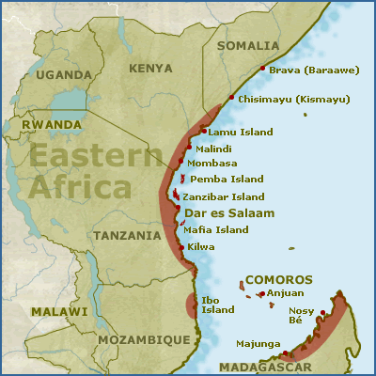
The Rise of the Swahili
The eastern coast of Africa
  Changed profoundly around first millennium CE
    Bantu-speaking from interior
      Migrated, settled along the coast
      Became farmers of bananas, remained herders
    Merchants and traders from the Muslim world, India
      Realized the strategic importance of the east coast of Africa
      Established commercial traffic, began to settle there
  From 900 CE onwards
    East Africa saw influx of Shirazi Arabs from the Persian Gulf
    Small settlements of Indians
    The Arabs called this region al-Zanj "The Blacks"
    Coastal areas came under control of Muslim merchants
  By the 1300's
    Major east African ports from Mombaza to Sofala
    Had become thoroughly Islamic cities and cultural centers
Swahili Language
  Grew out of a mix of Arabic and Bantu languages, means “coast”
  Swahili is primarily a Bantu language with some Arabic elements
  it is written in the Arabic alphabet
  Today language is spreading amongst East Africa as official language

Slide 30
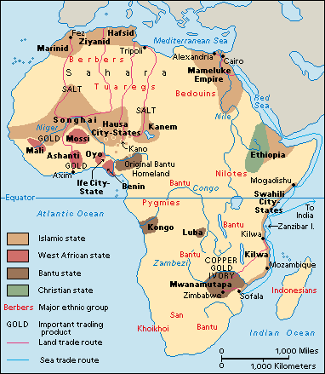
Hausa
People
Homeland
  Kano, Nigeria is center of Hausa trade and culture
  Culturally linked to Fulani, Songhai, Mandé, Tuareg
  A mix of Afro-Asiatic and Nilo-Saharan groups
500 CE – 700 CE
  Moved west from Nubia
  Intermixing with local peoples
  Established city-states in Northern, Eastern Nigeria
  City-states existed as islands amongst other peoples
  Emerged as the power after decline of Nok, Sokoto
Hausa have an ancient culture extending over a large area
  Strong, old ties to the Arabs, Islamized peoples in West Africa
  Ties extended through long distance trade
  Merchants moved across region from city to city
  Islam entered through trade but restricted to rulers, courts
  Hausa aristocracy adopted Islam in 11th c. CE
  Rural areas retained their animistic beliefs
The Fulani
  Invaded the Hausa area in 1810
  Often co-existed with the Hausa, interacted

Slide 31
The African Slave Trades
?BCE to ?CE

Slide 32
Generalized Facts About
Slavery, Slave Trades
Slavery is as old as recorded human history
  All societies have had slaves or a system similar to it
  Most slaves were captured in war or sold for debts
  Most slaves ended up as agricultural slaves
  To a lesser degree slaves were domestic servants
  To a lesser degree slaves were soldiers, artisans
  The most deadly slavery was in the mines, in the galleys, and eventually on the plantations
  In many societies slaves were protected to a degree by laws
Motives
  Labor Shortages would necessitate slavery
  A supply would be needed
  Profit would have to be great to cover expenses

Slide 33
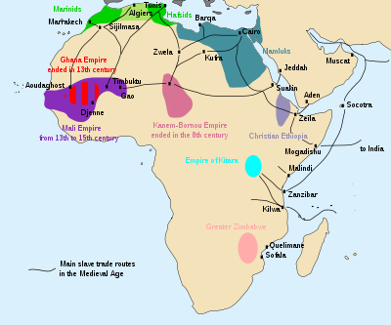
Trans-Saharan Slave Trade
Indian Ocean Slave Trade
The Arab slave trade lasted more than a millennium
  Ibn Battuta states that he was given , purchased slaves
  Arab slave trade originated with trans-Saharan slavery
    Arabs, Indians, Asians involved in the capture, transport of slaves
    Route was northward across the Sahara desert, Indian Ocean region
    Into Arabia and the Middle East, Persia, Central Asia and the Indian subcontinent
  The slave trade from East Africa to Arabia
    Dominated by Arab, African traders in coastal cities of East Africa
    Swahili wealth also due in large part to slave trade
    Iraq: black Zanj slaves constituted ½ total population
  The Moors
    European name for Berbers of North Africa
    In the 8th century began raiding coastal areas
    Became known as the Barbary pirates
    Slave trade suppressed in the 19th century
    Slaves included both African and Europeans
    Cervantes was held as a slave, later ransomed
  Male slaves
    Employed as servants, soldiers, or laborers
    Female slaves traded as domestic servants
Historical estimates
  11-17 million slaves taken
  Between 650 to 1900 CE
  British were strong abolitionists in region
  Slave trade continued into early 1900s
  Interpol evidence: it continues today

Slide 34
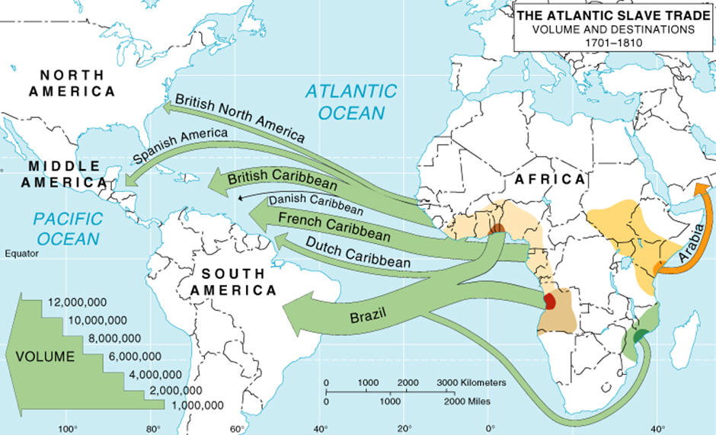
Mapping the Height of the
Atlantic Slave Trade

Slide 35
“Internal” Migration
The United States
  Civil War to World War I
    Was a war over slavery: free vs. slave labor
    Only real issue which divided US
    Republicans were abolitionist minded
    Southern senators, congressmen outnumbered
    Emancipation Proclamation, 13-15th Amendments
    Many ex-Slaves immigrated to west as cowboys, soldiers
  World War I and II
    Migration from South
      White men in army; black labor, workers needed
      Sought better lives and did not want to return to South
    Political rights were outgrowth of economic rights
  Change From 1890 to 2000
    90% lived in rural South
    Current: Most form an urbanized ethnic group
Brazil
  Most ex-slaves lived in the Northeast corner
    Location of sugar production
    Formed almost 90% of the population
  Changing Economic Structures
    Coffee production, diamonds & gold mining, industrialization occurred
    Afro-Brazilians moved southward, to cities to seek work
Caribbean Migration
  Afro-Caribbean migration to Florida, New York, London
  Economic factors push and pull immigration, families often followed
  Political instability in Cuba, Haiti, Dominican Republic
  Refugees result from Revolutions, harsh internal rule

Slide 36
Counter-Migration or Back to Africa
1787, 1821
  British established Sierra Leone
    To be “home” for freed, emancipated slaves
    74,000 slaves moved there
    Many tried to move back to homelands
  American anti-slavery activists established Liberia
    20,000 slaves moved there
    Ex-slaves came to monopolize power, formed elite class
In US: Marcus Garvey, Black Panthers, etc.
  During 1920s sought to convince blacks to move to Africa
  Black Resistance to oppression in US
Truth: Africans have become part of new homelands
  Some claim American blacks are seen as “whites” by Africans
  Black culture in Americas is a creole cultural blend
  Problem: accept blacks as equals in all ways in Americas
  Blacks have to join economic power with political power
  But blacks in many countries have to obtain political rights
    Mexico, Nicaragua, Panama
    Brazil
    Cuba, Puerto Rico
    Colombia, Venezuela, Peru

Slide 37
Manifest Destinies
Popular Movements To Settle Interior Lands

Slide 38
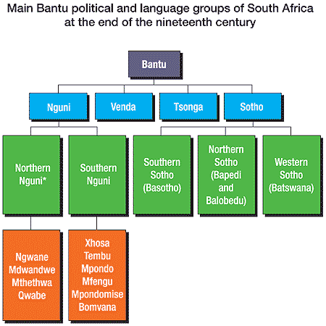
Nguni & Mfecane
Nguni
  Bantu tribal language family in Southern Africa
  Arrived 1600s in Cape area
  Arrive in area same time as Dutch settled Capetown
  Tribes: Zulu, Xhosa, Sotho, Swahzi, Nbelle, Shona
  Many moved into area following decline of Zimbabwe
  Corn introduced from Americas: rise of population
  Scarce resources during 10 year drought: conflict
Mfecane
  Zulu word for “the scattering,” or “crushing”
  Rise of Zulu Empire c. 1780 – 1840
  Created by Shaka Zulu, the use of modern iron swords, brilliant tactics, fierce mindset of warriors
  Zulu war machine forced Ngoni tribes to scatter
  Let to rise of Zulu-like states throughout region
Mfecane meets Great Trek
  British rule increasingly unacceptable to Dutch Farmer (Boer)
  British oppose slavery which Boers support
  Boer picked up entire communities and migrated to interior
  The Great Trek of Boers collided up against Mfecane, eventually defeat the Zulu (as do the British)

Slide 39
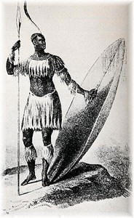
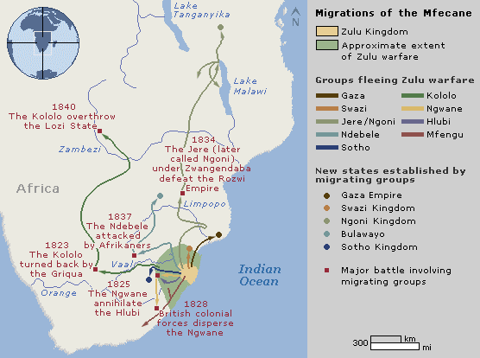
Mapping the Mfecane

Slide 40
19th and 20th Century
Migrations
Modern Mass
Movement

Slide 41
The Facts
Most common types
  Labor migration
  Refugee migration
  Urbanization
18th Century Immigration
  Accelerated over time period
  Largest examples were the African slave trades
  Colonization of territories common
19th Century Immigration
  Caused by industrialization and opening of interior lands
  Large demand for labor to replace slaves, work factories, plantations
  Facilitated by modern developments in transportation
  International Trade and Imperialism are influencing factors
  Remade the Americas, Australia
20th Century Immigration
  Cannot understand modern world without immigration
  Economic and Social Globalization and modern immigration are linked
  Economic disparities, decolonization, and war are critical
  Intellectual migration has become quite common

Slide 42
19th c. Demographic Revolution
Causes
  Massive Population Surge beginning in West
    Immediate Results Prior to Industrialization
      Massive insecurity
      Temporary migration
    Growth of Cities and Urbanization due to Industrialization
    By 1900 had begun to spread to Japan, Russia, Eastern Europe
  Rural economies replaced by urban industrial economies in West
    Enclosure movements around the world
    Food shortages such as Irish Potato Famine
    Industrialization and Urbanization demanded all types of labor
  Need to replace slavery, serfdom in some areas of the world
New Circular Migration Patterns
  Commercialization of agriculture produced new labor demands
  Short term labor common, replaces year round farm labor
  New Migrant Labor for farming, construction of infrastructure
  Migration of women as laborers became common
  Higher mobility of people including labor

Slide 43
19th c. The Atlantic World
stern/NorthWest Europe saw urbanization, migration of labor from farms to industry
Africa
  Slave trade continued until early 20th century
    Atlantic Slave trade largely ended by 1820
    Illegal Slave Trade to Brazil continued until c. 1850
    Trans-Saharan and Indian Ocean Slave Trades continued until c. 1910
  Popular Migrations
    Boer Great Trek from Capetown to Interior to avoid British influence, control
    Mfecane in South Africa due to Zulu wars spreads Nguni to Southern Africa
    Migration of Somali into Ogden, East Africa due to drought
    Large colonial settlement of Europeans to Algeria, Tunisia, Libya, South Africa
    Muslim jihads on West African Sahel produce migrations of people across region
    Africans move to work gold, rubber, diamond, industrial concerns of Europeans
The Americas
  19th Century
    Largest recipients were the USA, Canada, Brazil, Argentina, Uruguay
    USA, Canada received large populations from Ireland, Germany, Scandinavia
  Settlement of the Frontier
    Mexico, USA, Canada, Brazil, Argentina all settled their frontiers
    All attempted to attract settlers and laborers with good salaries, grant of land

Slide 44
19th c. Asian Migration to Africa
South and Southeast Asia
  50 million Indians, Chinese, Malay, Filipinos migrated as contract laborers
    Commercial labor settled in thriving cities, ports
    Physical labor worked tea, rubber, rice, sugar, coffee plantations
  Indians (Both Hindu and Muslims)
    Went to African plantations as contract laborers, physical laborers
    Many voluntarily moved to Africa to establish businesses to serve migrants
    British used Indians as lower colonial administrators in their Asian empire
Indians in East Africa
  First arrived as coolie laborers in late 1800s to build the Ugandan Railway
    Original 32,000 contracted laborers
    Many stayed as shopkeepers, artisans, traders, clerks, low level administrators
    Excluded from middle, senior ranks of the colonial government, from farming
    Became commercial middleman, professional community including doctors, lawyers
    Indian traders followed Arab trading routes inland on the coasts of East Africa
    Indians had monopoly on Zanzibar's trade in 19th century
  Between the building of the railways and the end of World War II
    Number of Indians in East Africa swelled to 320,000
    By 1940s: some colonial areas passed laws restricting the flow of immigrants
    The Indians had firmly established control of commercial trade
    80 to 90 percent in Kenya, Uganda plus sections of industrial development
    In 1948, all but 12 of Uganda's 195 cotton ginneries were Indian run
Indians in South Africa
  The majority of the Asian South African population is Indian in origin
  Most of them descended from indentured workers
  Transported to work in 19th century on sugar plantations of Natal
  They are largely English speaking
  1.2 million Asians in South Africa represent 2% of South Africa’s population
  Gandhi worked as lawyer in South Africa amongst immigrant workers
  African National Congress modeled after Indian National Congress

Slide 45
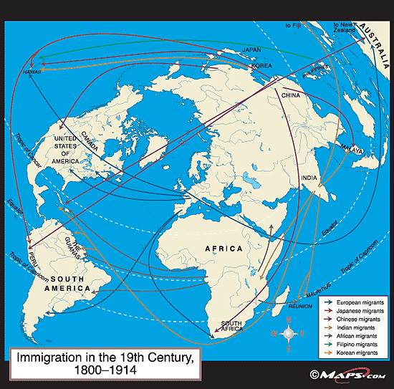
Migration 1800 to 1914

Slide 46
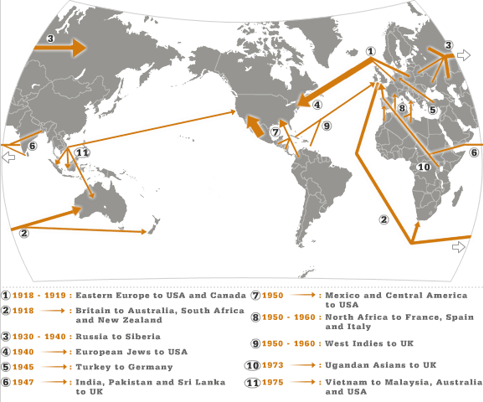
Major 20th c. Migrations

Slide 47
Immigration and World Wars
World War I and After
  Refugees produced by warfare in record numbers
  Millions of colonial subjects migrated to fronts to support war
    100,000 Vietnamese; 100,000 Chinese, 100,000 Africans
    Many worked in Europe, at war fronts as laborers
  Peace Treaty produced immigration
    Germans expelled from former territories
    Turks expelled from Europe
    Greeks expelled from Turkey
  Armenian Genocide
    Millions of Armenians migrated from SW Asia to Americas
  Increased Jewish migration to Palestine reached 400,000 by 1948
The Soviet Union’s Migrations
  3 million refugees (ethnic groups, elite) fled communist revolutions to west
  USSR resettled peoples whom they distrusted
World War II
  Japanese invasion of China created up to 50 million internal immigrants
  Nazis used forced settlement, internal migration
    Millions of Germans settled in occupied Eastern lands
    European Jews rounded up and shipped to Eastern Europe
    Millions of Europeans used as slave labor in German factories
  Prisoners of War and Refugees number in millions
  End of War Expulsions and Resettlement
    Allies expelled millennia old German populations from Eastern, Central Europe
    Millions of Poles, Czechs, Ukrainians, Romanians resettled in former German lands
  Soviets forcibly resettled 100,000+ Eastern Europeans into USSR

Slide 48
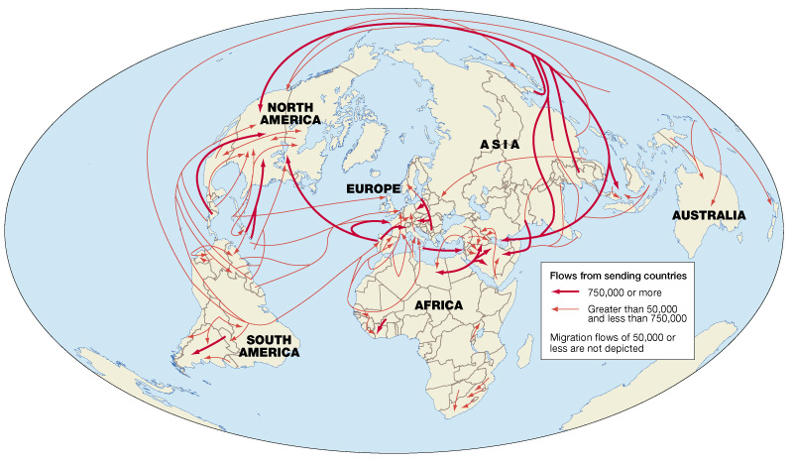
Mapping Migration since 1945

Slide 49
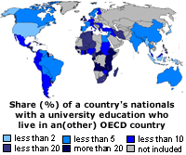
Labor Migration Since 1945
Causes
  Developed world of rich nations attracted labor and brain power with higher pay
  The bulk of immigrants were laborers when labor was needed
  Many ethnic commercial minorities felt threatened and moved
  Population in 3rd world high; birth rates in 1st world declined = labor shortage
  1st world citizens increasingly abandoned agriculture = need for farm labor
  Construction laborers needed in urbanizing world
  The famous Brain Drain of the educated elite to the 1st World
Sources: Poor & Smart Migrate
  Net Recipients
    United States, Canada, Western Europe
    Persian Gulf States
    Japan and Australia
    South Africa
  Net Suppliers
    Eastern and Southern Europeans to Northern and Western Europe
    South Asian Muslims to the Persian Gulf States
    North Africans, West Africans to West Europe especially Spain, France, Portugal, Italy and UK
    Central Americans to the United States and Canada
    The Caribbean to the United States and United Kingdom
    Southeast Asians to France, the United States, and Australia
    Turks to Germany and Austria
    Irish to the United Kingdom and Continental Europe
    Chinese to the United States and Canada
    Southern African males to South African diamond, gold mines and industry

Slide 50
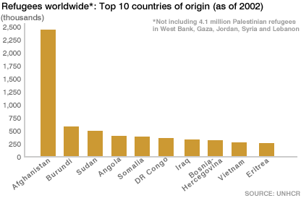
Refugee/Asylum Migration Since 1945
Causes
  Cold War Rivalry between Great Powers
  Revolutions and Military Coups
  Genocide and Ethnic Cleansing
  War between Neighbors
  Persecuted Religious Minorities
Total: 80 million by 1994
Sources
  Warfare of all types
    Ethnic minorities relocated in many nations by Allied Nations especially German populations
    Korea, Vietnam, Berlin Crisis, Hungarian Crisis, Prague Spring all produced refugees
    The Middle East, Afghanistan, Georgia, Chechnya, and Civil Wars in Congo (Zaire)
  Collapse of Communism
    Many ethnic minorities, talented individuals sought refugee in the West and United States
  Authoritarian Violence
    Military regimes, violence against citizens: Chile, Argentina, Brazil, Mexico, South Africa
  Revolutions
    Forcible takeover of states by revolutionaries: Cuba, Algeria, Iran, Vietnam
  Ethnic Cleansing and Genocide
    Bosnia, Rwanda, Sudan, Cambodia
  Nationalism
    Newly independent nations produced migrants of ethnic minorities threatened by change

