Slide 1
Analyze the images and information on the following slides with this question in mind:
What were some social changes that resulted from increasing global economic opportunities and imperial conquests in the early modern era? Specifically, think about changes in ethnic, racial, and gender hierarchies.

Slide 2
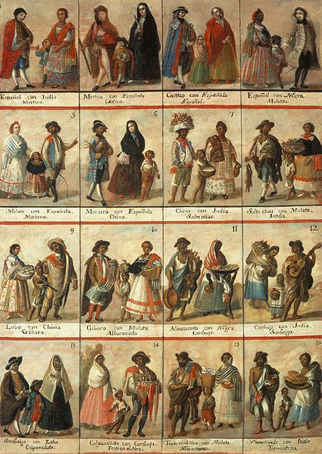
“Las Castas”
This painting shows 16 casta combinations. In the 18th century a socio-racial classification system developed in the Spanish American colonies.
The European conquest of Latin America beginning in the late 15th century was initially executed by male soldiers and sailors from the Iberian Peninsula (Spain and Portugal). These new soldier-settlers fathered children with Amerindian women and later with African slaves. These mixed-race children were generally identified by the Spanish and Portuguese colonists as “Castas”.
Casta is an Iberian word (existing in Spanish, Portuguese and other Iberian languages since the Middle Ages), meaning “lineage”, “breed” or “race.” It is derived from the older Latin word castus, “chaste,” implying that the lineage has been kept pure. Casta gave rise to the English word caste during the Early Modern Period.
http://nativeheritageproject.com/2013/06/15/las-castas-spanish-racial-classifications/

Slide 3
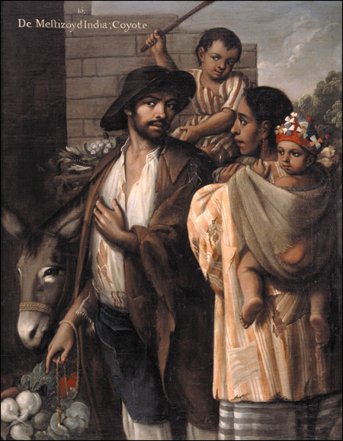
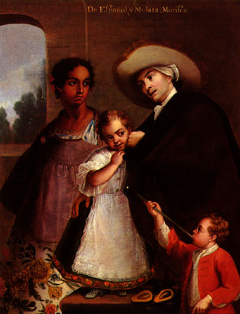
E Español y Mulata, Morisca
Miguel Cabrera, 1763
Casta Painting No. 15.
From Mestizo and from Indian; Coyote
Miguel Cabrera, 1763

Slide 4
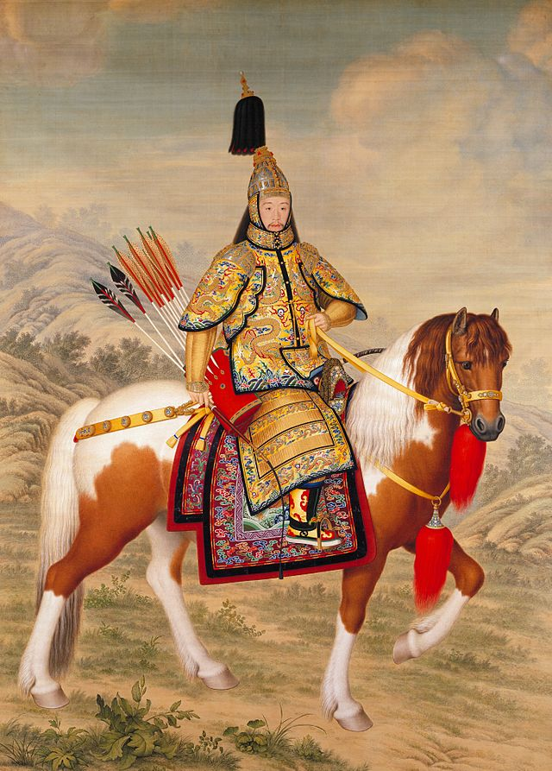
The Qianlong Emperor was the sixth emperor of the Manchu-led Qing Dynasty, and the fourth Qing emperor to rule over China. The fourth son of theYongzheng Emperor, his reign officially began11 October 1735, lasting for 60 years. Named Hongli, he chose the era name Qianlong, meaning "heavenly prosperity". Although his early years saw the continuation of an era of prosperity and great military success in China, his final years saw troubles at home and abroad converge on the Qing Empire. Qianlong abdicated the throne at the age of 85, to his son, the Jiaqing Emperor, fulfilling his promise not to reign longer than his grandfather, the Kangxi Emperor.
Artist: Giuseppe Castiglione, 18th Century (Castiglione was a Jesuit missionary in China)

Slide 5
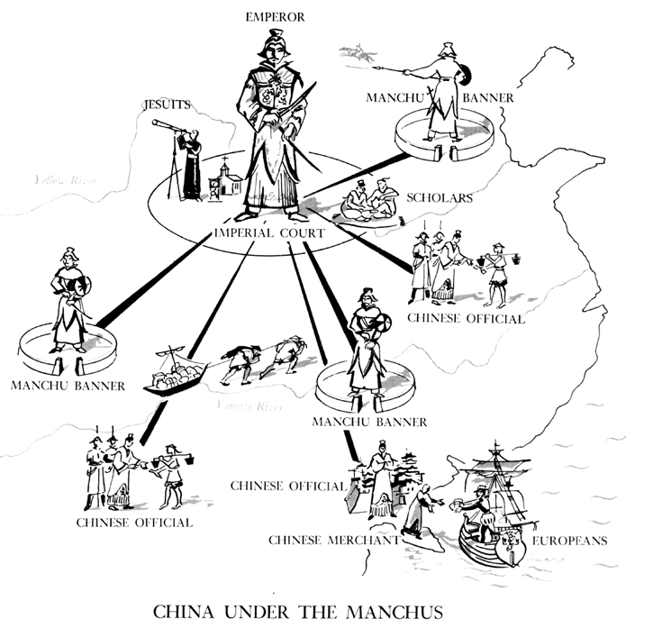
The emperor and his banners are depicted in the dress of a Manchu, distinguishing them from the Chinese officials. This reflects the Manchu policy of separating the civic functions of the empire, carried out by Chinese officials, from the military functions, performed by the Manchus. Notably, the emperor is not seated upon a throne; he is depicted as a military figure more than as the Son of Heaven. Within his court are Chinese scholars as well as Jesuits, who bring Western science and technology in addition to a new religion. The scholars, however, sit at opposite sides of the emperor; unlike the merchant who welcomes trade in European goods with open arms, the Chinese scholars seem at best disinterested in the Jesuit's intellectual goods. The dark lines connecting all these various activities to the imperial court suggests order and control over the whole of the empire.
http://library.osu.edu/projects/belapetheo/china_under_the_manchus.htm

Slide 6
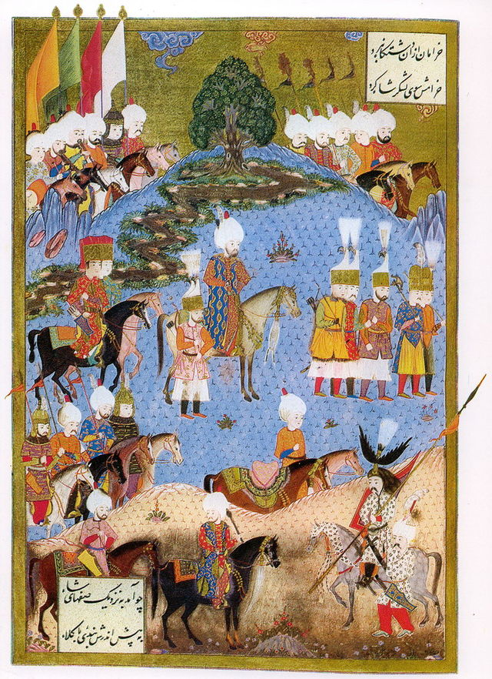
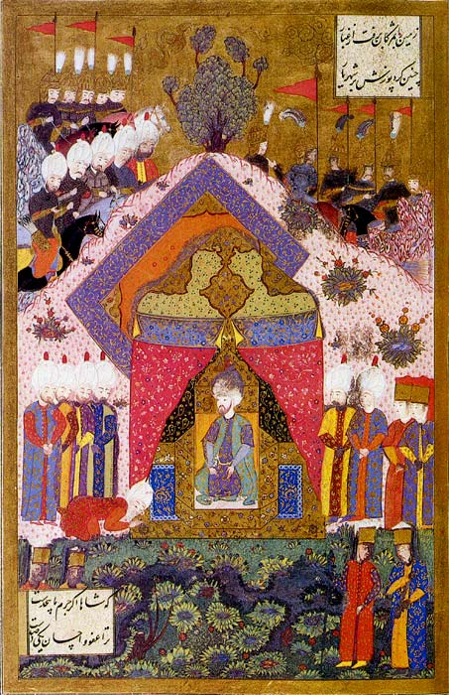
Miniature of Suleiman the Magnificent receiving an ambassador.
Miniature depicting Suleiman marching with an army, summer 1554

Slide 7
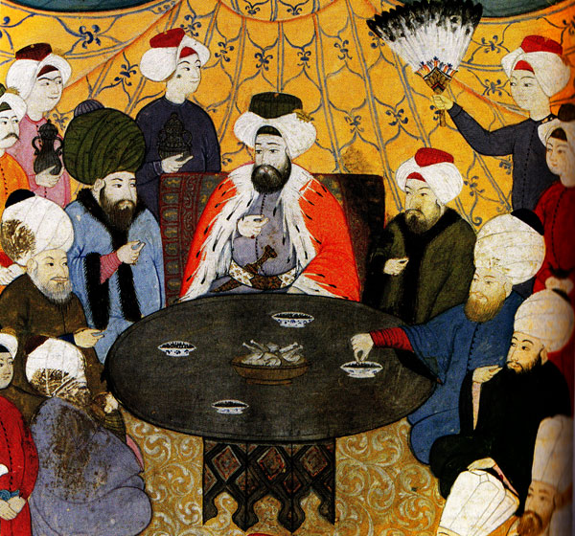
Ottoman elite at a feast.

Slide 8
“...A remarkable thing which I saw in this country was the respect shown to women by the Turks, for they hold a more dignified position than the men. ... I saw also the wives of the merchants and common [men]. [Their faces are] visible for the Turkish women do not veil themselves. Sometimes a woman will be accompanied by her husband and anyone seeing him would take him for one of her servants.”
-Excerpt from the journal of Ibn Battuta, a Moroccan traveler in the 1300’s (at a time when we first start to see the growing prominence of Turkic peoples in the Muslim world.)

