Slide 1
Unit Three: Regional and Trans-regional Interactions
c. 600 CE to c. 1450 CE

Slide 2
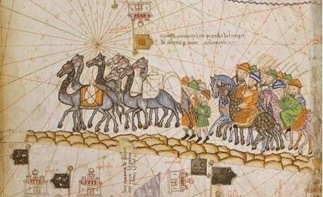
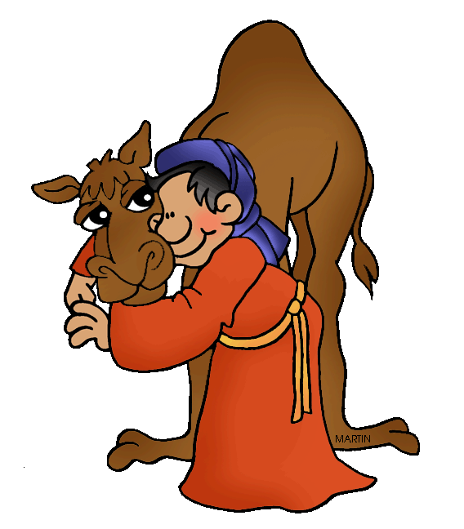
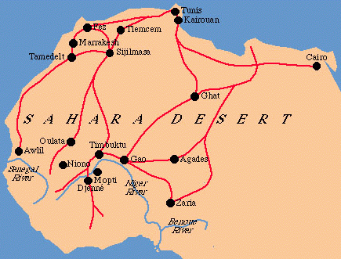
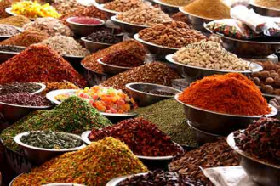
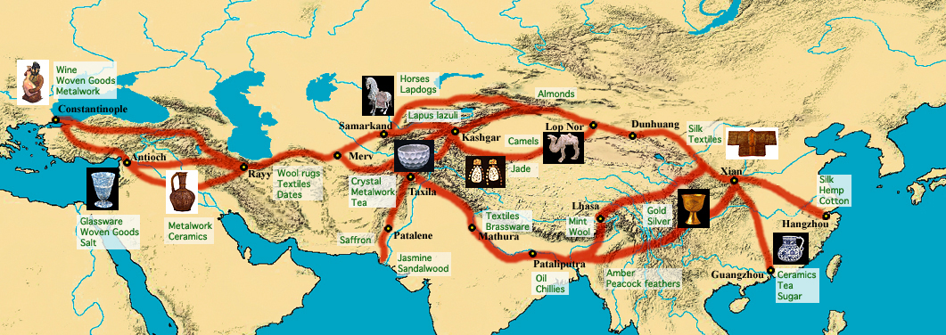
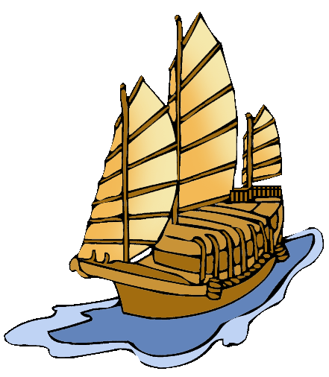


K
E
Y
C
O
N
C
E
P
T
3.1 Expansion and Intensification of Communication and Exchange Networks

Slide 3
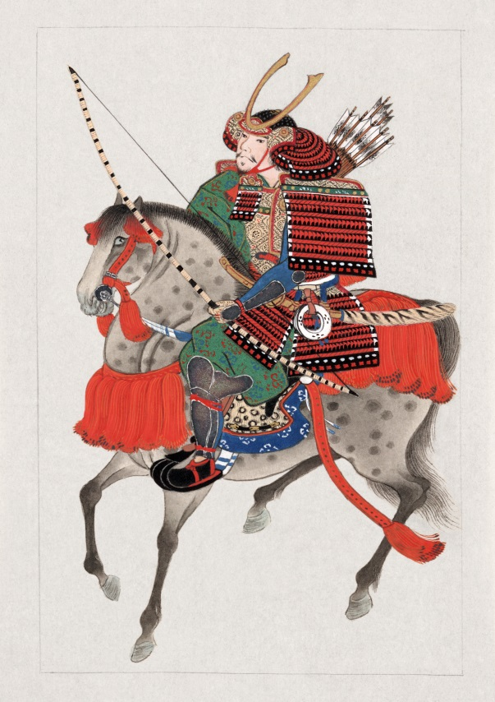
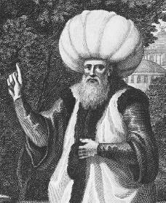
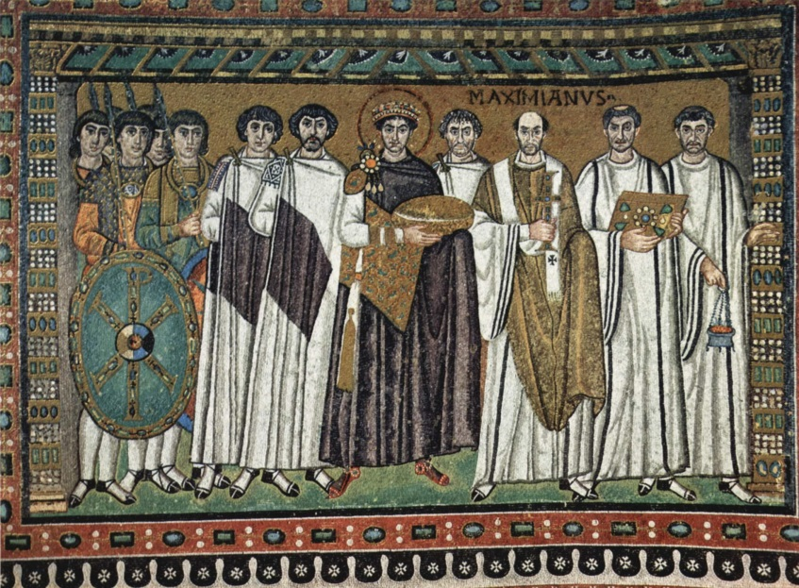
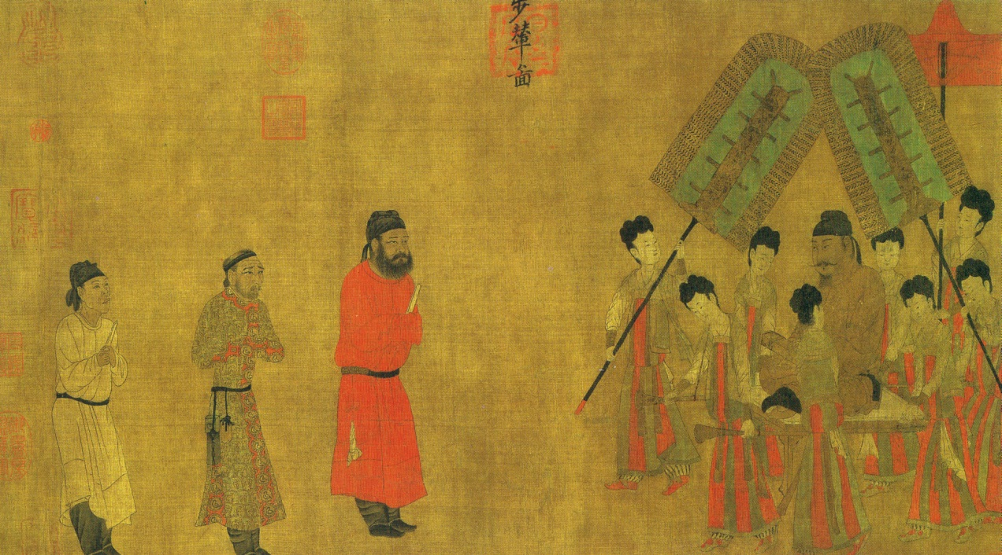
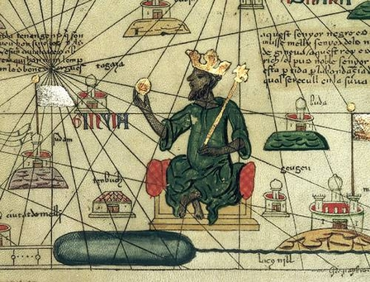
K
E
Y
C
O
N
C
E
P
T
3.2 Continuity and Innovation of State Forms and
Their Interactions

Slide 4

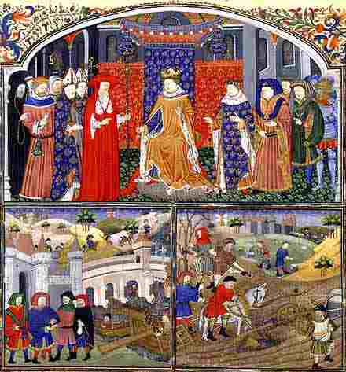
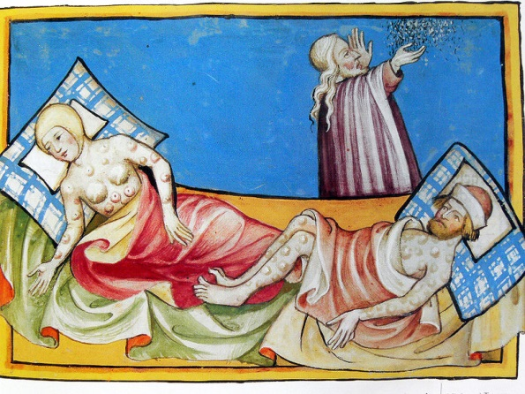
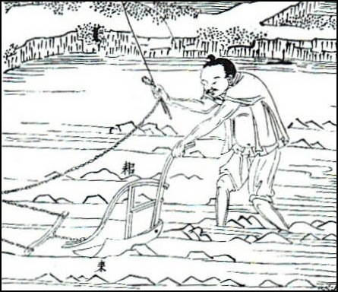
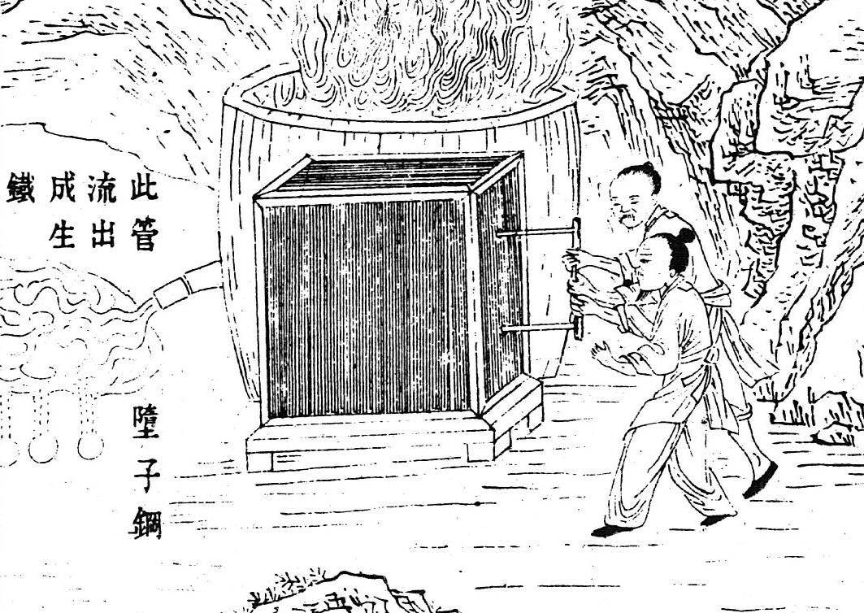
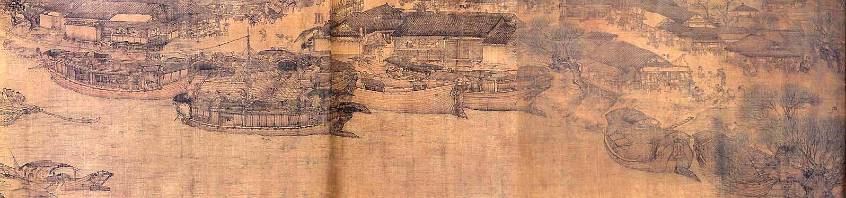
K
E
Y
C
O
N
C
E
P
T
3.3 Increased Economic Productive Capacity and Its Consequences

Slide 5
  Chapter 13 – The Resurgence of Empire in East Asia
  Chapter 14 – The Expansive Realm of Islam
  Chapter 15 – India and the Indian Ocean Basin
  Chapter 16 – The Two Worlds of Christendom
  (Test)
  Chapter 17 – Nomadic Empires and Eurasian Integration
  Chapter 18 – States and Societies of Sub-Saharan Africa
  Chapter 20 - Worlds Apart: The Americas and Oceania
  Chapter 19 – The Increasing Influence of Europe
  Chapter 21 – Expanding Horizons of Cross-Cultural Interaction
  (Test)
Unit 3 Chapters
Make sure all this info plus the key concepts are on your Unit 3 title page.

