Slide 1
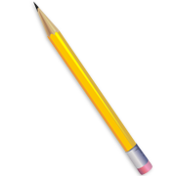
Why did the Soviet Union Collapse?
Ethnic unrest – resistance to assimilation into a Russianized state (over 50% of the population of the U.S.S.R. was not ethnically Russian)
Economic inefficiency in a huge command economy with a huge bureaucracy (sometimes called the politburo)
Arms race – the U.S.S.R. could not keep up with the United States
Invasion of Afghanistan (1979-1988) – a ten year war that drained resources and ended in defeat and withdrawal
Gorbachev’s willingness to reform and change (perestroika, glasnost)
Nationalist/separatist movements led to the lack of cooperation from officials in the republics (the first region to produce mass, organized dissent: the Baltic in 1987)

Slide 2
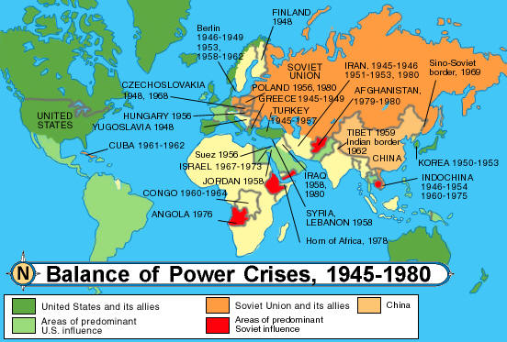

Slide 3
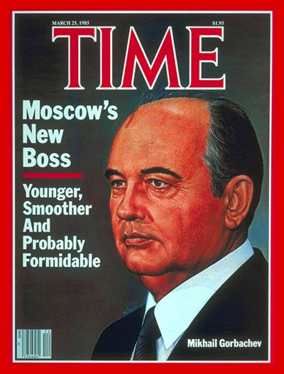
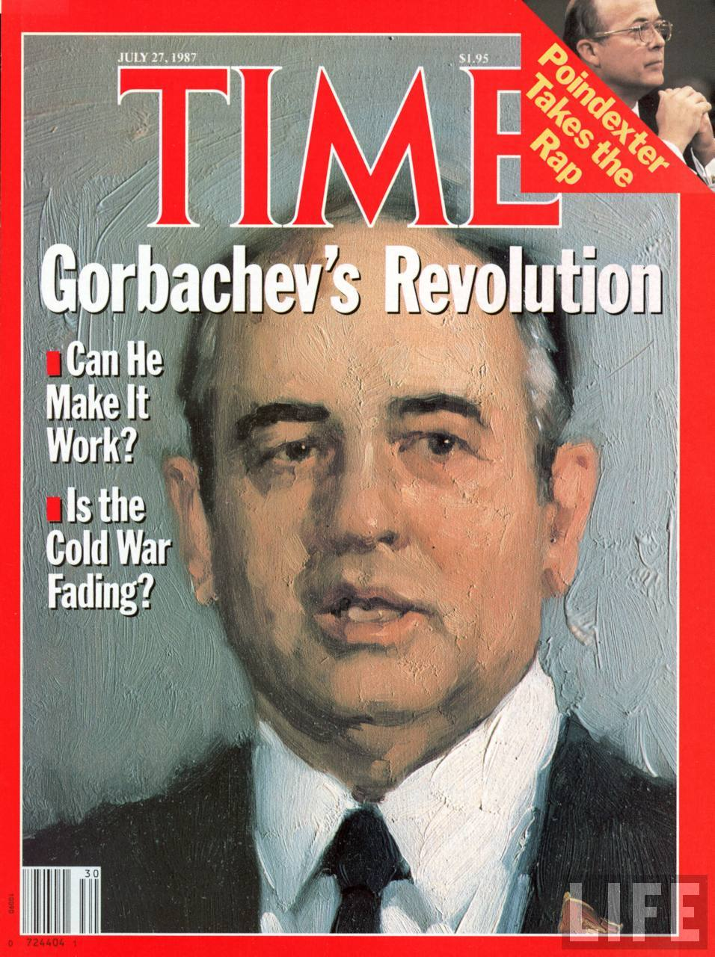
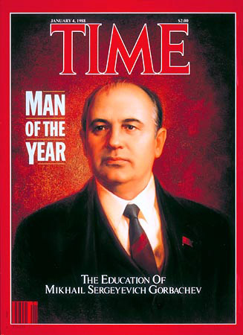
Mikhail Gorbachev was the leader of the U.S.S.R. who began the reforms and changes of glasnost and perestroika in the 1980’s.

Slide 4
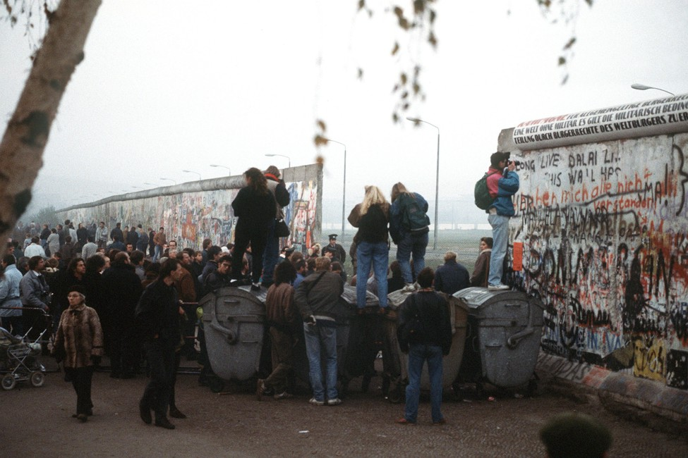
As glasnost and perestroika began to change the U.S.S.R., people were emboldened to defy the old system. The wall came down in 1989, and Germany was reunited in 1990.

Slide 5
