Slide 1
The Transition from Early to Late Medieval Times in Western Europe
Characteristics of the Early Middle Ages: (Review)
Missionaries, monks, and friars spread Christianity throughout Europe
Charlemagne’s empire and legacy
Invasions, warfare, and instability (Vikings, Magyars, etc.)
Feudalism and manorialism
Characteristics of The Late Middle Ages:
New agricultural techniques →more food production and storage → increase in population → growth of towns → revival of trade
Trade fairs
New business practices
A middle class begins to emerge
Formation of guilds

Slide 2
More Characteristics of The Late Middle Ages:
Strengthening of monarchies
The Crusades
The plague
Formation of the first universities
The Hundred Years’ War
Dissention in the church
Formation of the first nation-states in western Europe

Slide 3
The High Middle Ages in Western Europe
From about 1050 C.E. to 1450 C.E.

Slide 4
Postclassical Britain
The Native Inhabitants were the Celts.
Groups who settled on the British Isles included:
1. Germanic tribes such as the Angles, Saxons, and Jutes
2. Danish and Norman Vikings
Alfred of Wessex/Alfred the Great (r. 871 – 899)
1. United the Anglo Saxons in order to stop Viking invasions
2. Defeated the Danes (Vikings from Denmark)
3. Founded schools and hired scholars to translate Latin works
4. Commissioned a group of scholars to write a history of England; this famous work became the Anglo-Saxon Chronicle
5. Anglo-Saxon rulers that succeeded Alfred were weak
6. The last Anglo-Saxon king died in 1066 (Edward the Confessor)

Slide 5
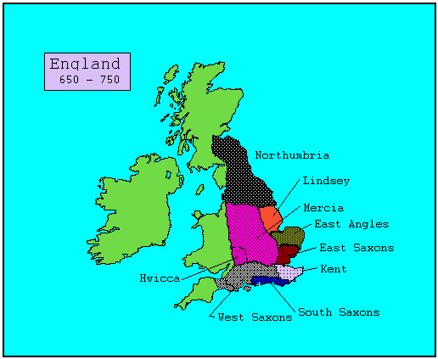

Slide 6
William the Conqueror
1. Duke of Normandy (Normandy is located along the coast of France); cousin of the last Anglo-Saxon King and a vassal of the French king.
2. William invaded England in 1066 and defeated the Anglo- Saxons at the Battle of Hastings.
3. As king of England William had a French speaking court and advisors.
4. William assessed the wealth of his new kingdom by ordering a census in 1086. This became the famous Domesday Book.
5. Norman-French and Anglo-Saxon cultures and customs blended over the next 300 years of Norman rule in England.
6. Norman rule marked the beginning of the strengthening of the English monarchy.

Slide 7
William’s Heirs (Plantagenets)
1. Henry I – created a treasury for collected taxes (exchequer)
2. Henry II – set up a common law system
- powerful wife Eleanor of Aquitaine brought French lands to the English Kingdom
- famous sons Richard the Lionheart and John would become kings
- The attempts of Henry II to regulate the Church led to a famous scandal: the assassination of the Archbishop of Canterbury Thomas Beckett
3. Richard the Lionheart – fought in the Third Crusade
4. King John – lost lands to the French, was excommunicated by the pope, and was forced to sign the Magna Carta by English nobles
The Magna Carta was a landmark in history because it was the first step in limiting the power of the monarchy in England.
1. Due process of law
2. Right to jury trial
3. Beginning of the parliamentary system in England

Slide 8
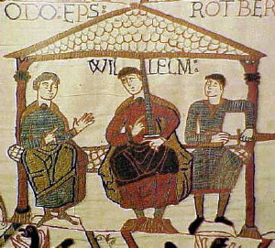
The Bayeux Tapestry

Slide 9
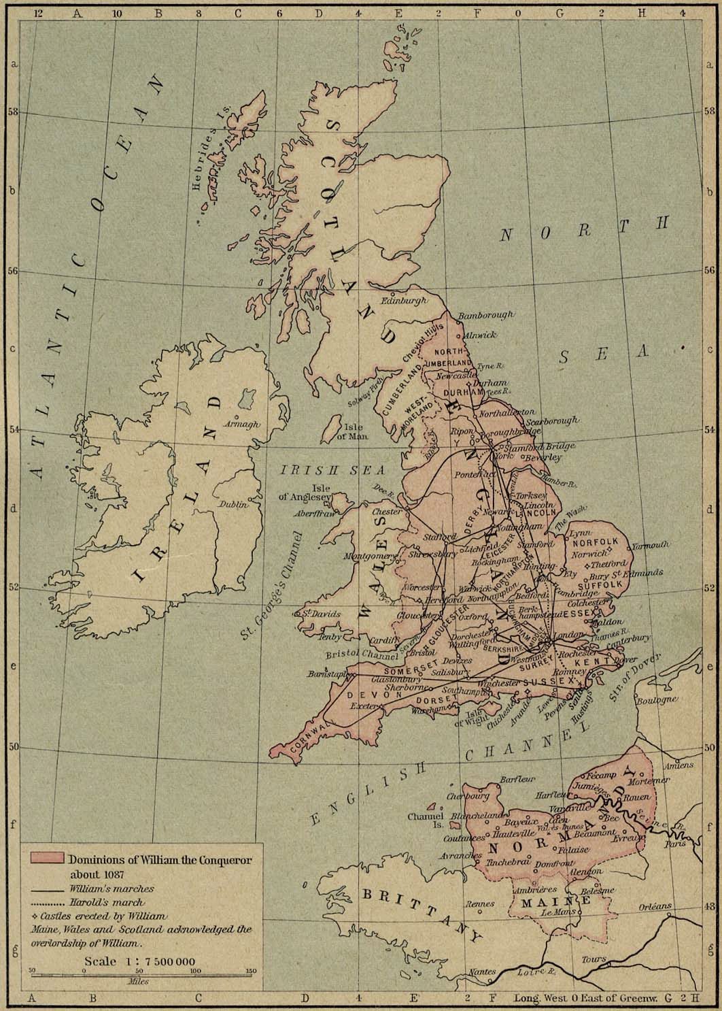
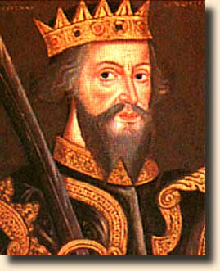
William the Conqueror

Slide 10
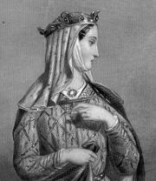
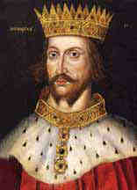
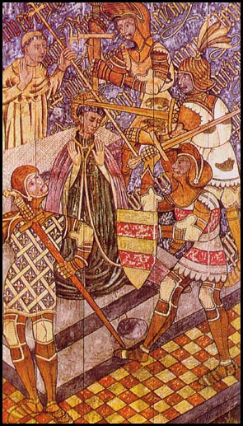
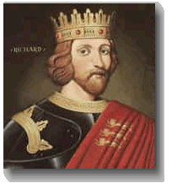
King Henry II
Eleanor of Aquitaine
The Murder of Thomas Beckett
Richard I (Lionheart)

Slide 11
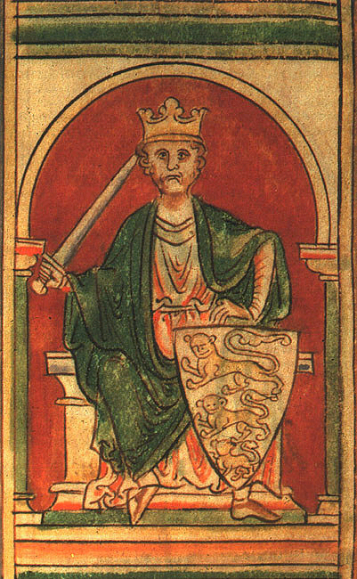
King Richard I
(a.k.a. Richard the Lionheart, famous for fighting in 3rd Crusade)

Slide 12
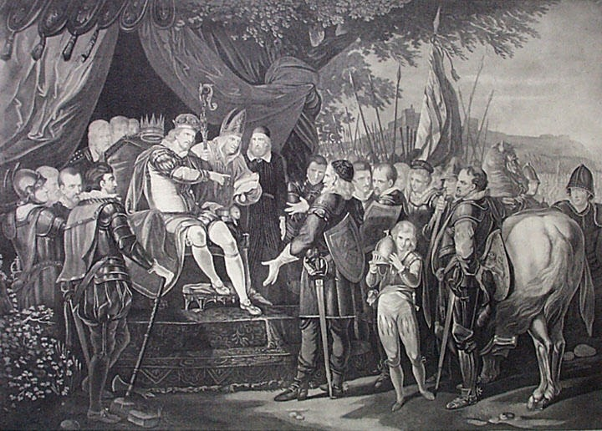
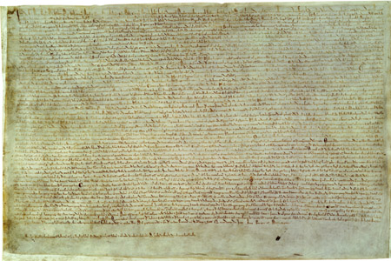
The Magna Carta

Slide 13
Evolution of English government during the High Middle Ages
1066 – Norman conquest; beginning of strengthening of central government in England
1086 – Domesday Book
1160’s-1180’s – development of common law system
1215 – MAGNA CARTA
1295 – Model Parliament convenes under Edward I

Slide 14
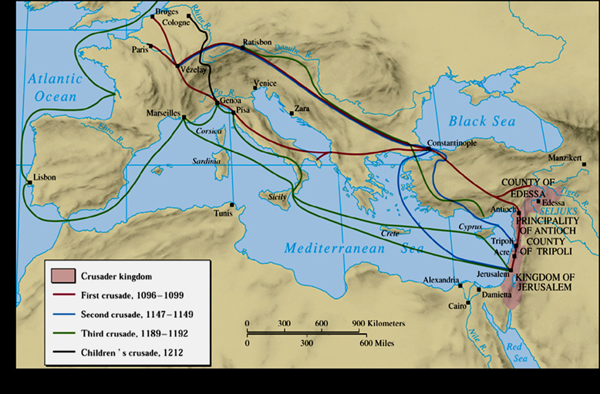
The Crusades

Slide 15
Causes for the Crusades
(Began in 1095, lasted for about 200 years)
Why did Pope Urban II call for a Crusade?
To unite European Christians
To make secular rulers (kings and nobles) vassals under his spiritual leadership
To subject Eastern Orthodox churches to Rome
To gain control of land and territory
Why did people go off on Crusades?
Religious zeal – the desire to control the holy lands and earn salvation
Desire to win wealth and land – especially for second born sons who would not inherit family wealth
Adventure, glory
Desire to escape the economic and social problems in western Europe
Merchants wanted the opportunity to expand trade

Slide 16
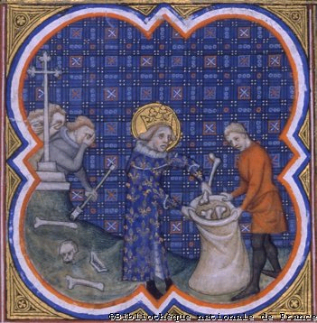
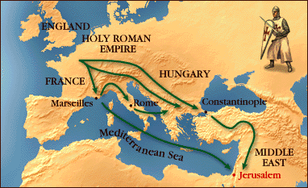
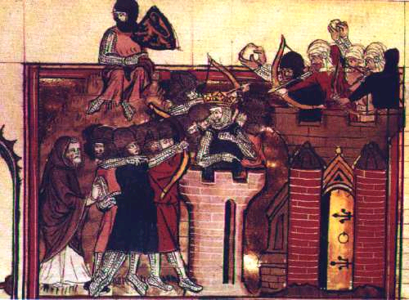
Louis IX burying the dead in the wake of the executions after his crusade failed in 1229

Slide 17
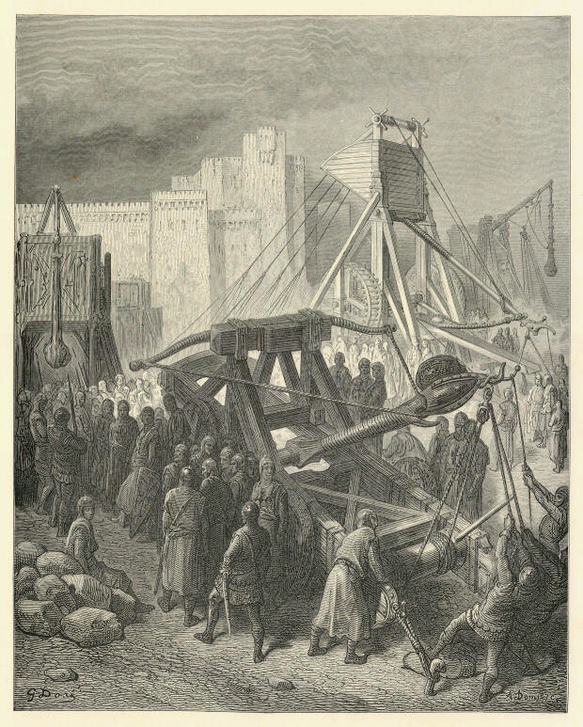
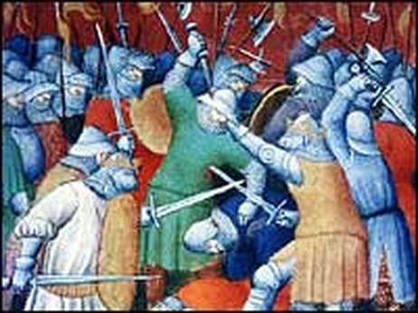
Crusaders’ siege weapons
Manuscript illustration of the taking of Damietta during the Fifth Crusade.

Slide 18
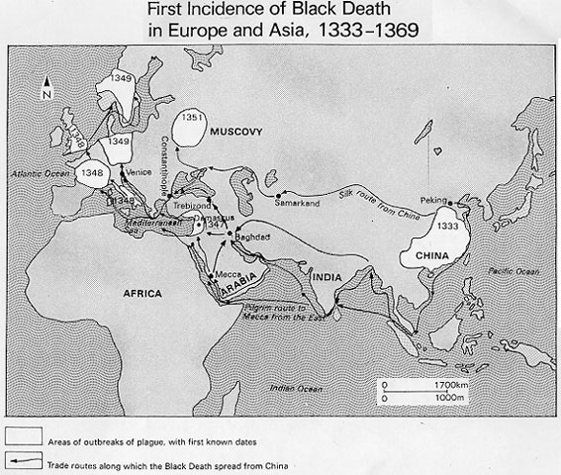
The Black Plague hit Europe especially hard in the years 1347-1350. It spread along trade routes, and killed as many as 1 out of 3 Europeans. It had profound social, political, and economic effects in Europe.

Slide 19
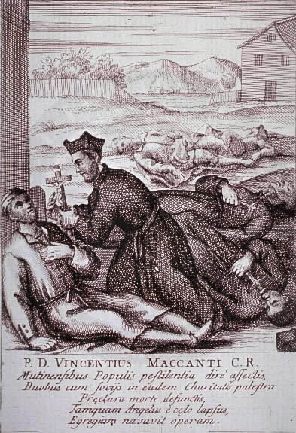
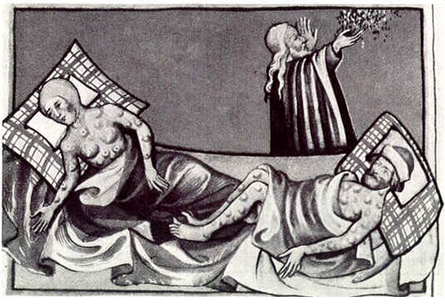

Slide 20
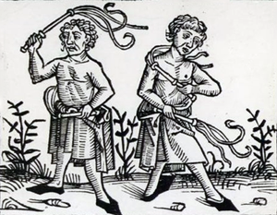
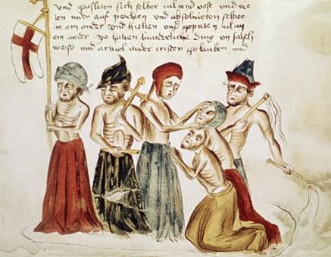
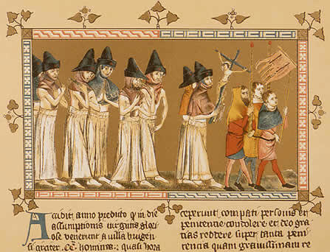

Slide 21
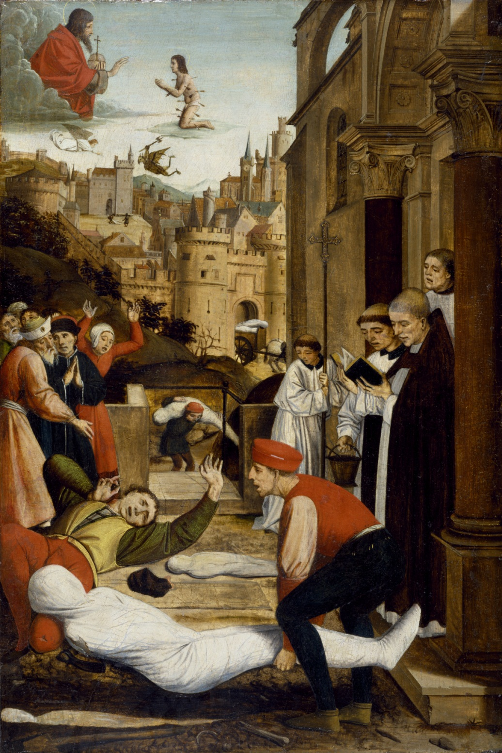
Josse Lieferinxe
Saint Sebastian Interceding for the Plague Stricken
Painted between 1497 and 1499

Slide 22
The Hundred Years War (1337-1453)
The Hundred Years War was fought between France and England. England’s rulers wanted to keep control over French lands that had been added to the English kingdom beginning with William the Conqueror.
Other French lands had been added to the English Kingdom over the years (such as Aquitaine, gained when Henry II married Eleanor of Aquitaine.)
Disputed territories included Gascony, Normandy, and Aquitaine.

Slide 23
A sense of nationalism began to develop among the French.
England dominated the early years of the war, in part due to the development of the longbow. For example, the English soundly defeated the French at the Battle of Crecy in 1346.
The fighting did not last non-stop for 116 years; for example, there was a 20 year truce from 1396-1415.
The tide of war turned in 1429 when Joan of Arc helped the French win the Battle of Orleans.

Slide 24
Effects of the Hundred Years War
Although the French ultimately won the war, France suffered more severely than England. Battles were fought on French soil which devastated the land, economy, and population.
French nationalism and unity increased.
Feudalism continued to break down as national armies replaced feudal armies.
Monarchies grew stronger.
England’s hopes of becoming a continental power ended. They began to focus on strengthening naval power.

Slide 25
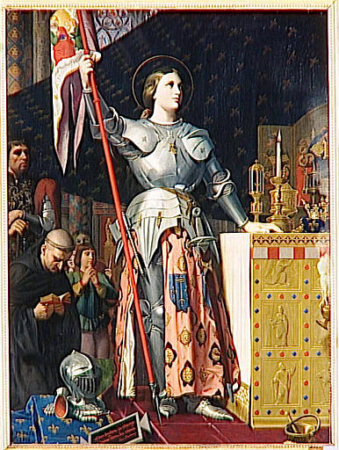
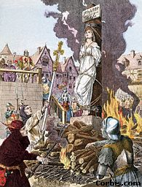
Joan of Arc

Slide 26
Notes from the Texbook: Chapter 19
The Increasing Influence of Europe

Slide 27
The Declining Byzantine Empire: Challenges from the West
Remember, the Byzantines had lost territory throughout the postclassical period due to the expanding Abbassids and Turkic states
Plus, in the later postclassical centuries there was more competition from the West, due to increasingly dynamic western European economic development
Normans from Scandinavia pressed on Byzantine territories
Crusades of twelfth and thirteenth centuries rampaged through Byzantine territory
Constantinople sacked, 1204

Slide 28
Challenges from the East
Invasion of Anatolia by Muslim Saljuqs (Seljuks)
Grain supply threatened
Defeat of Byzantine army in 1071 created civil conflict
Period of steady decline until Ottoman Turks, under Mehmed II, captured Constantinople in 1453
Renamed Istanbul

Slide 29
The Regional States of Medieval Europe, 1000–1300 C.E.

Slide 30
The Holy Roman Empire
Otto I of Saxony took advantage of decline of Carolingian empire to establish kingdom in north Germany, mid-tenth century C.E.
Military forays into eastern Europe
Twice entered Italy to aid Roman Catholic church
Otto named emperor of Holy Roman Empire, 962 C.E., by Pope John XII

Slide 31
Investiture Contest
Late eleventh to early twelfth century
Pope Gregory VII (1073–1085) attempted to end practice of lay investiture
Excommunicated Emperor Henry IV (1056–1106)

Slide 32
Regional Monarchies in France and England
Capetian France
Last Carolingian Emperor succeeded by Hugh Capet, 987 C.E.
Slowly expands authority out from Paris
The Normans
Invaded England in 1066 under William the Conqueror
Dominated Angles, Saxons, and other Germanic groups

Slide 33
Regional States in Italy
Series of ecclesiastical states, city-states, and principalities
Papal State directly controlled by Pope, good-sized territory in central Italy
By twelfth century, city-states increasingly displaced church control in northern Italy
Norman invasion of southern Italy; Byzantine and Muslim authorities displaced

Slide 34
Regional States in Iberia
Muslims controlled Iberian peninsula from eighth to twelfth century
From eleventh century on, Christian conquests of Spanish Muslim territories
Late thirteenth century, Muslims remained only in Granada

Slide 35
Growth of the Agricultural Economy
Increasing development of arable lands
Minimized threat of invading nomads
Clearing of swamps, forests
Improved agricultural techniques
Crop rotation
New crops, especially beans
Horseshoes, horse collars (horses faster than oxen)

Slide 36
European Population Growth, 800–1300 C.E.

Slide 37
The Revival of Towns and Trade
Urbanization followed increases in food supply
Specialization of labor
Textile production
Mediterranean trade
Italy well-positioned for sea trade
Italian colonies established in major ports of Mediterranean, Black Sea

Slide 38
The Hanseatic League
“Hansa,” association of trading cities
Trade in Baltic and North seas
Poland, northern Germany, Scandinavia

Slide 39
Major Trade Routes of Medieval Europe

Slide 40
Social Change
The three estates:
Those who pray: clergy
Those who fight: knights
Those who work: peasants
Oversimplification of complex social reality

Slide 41
Guilds
Organizations of merchants, workers, artisans
By thirteenth century, guilds controlled good portion of urban economy
Price and quality control
Membership
Created social support network

Slide 42
The Medieval Expansion of Christian Europe
Reconquista in Spain
Atlantic and Baltic colonization
Exploration of North Atlantic Ocean by Scandinavians
Iceland, Greenland, Vinland (Canada)
Canadian settlements do not succeed
Kings of Denmark nominally converted to Christianity; Sweden and Finland followed

Slide 43
The Crusades
Pope Urban II called for liberation of Jerusalem from Muslim control, 1095
Council of Clermont
“Deus vult”—“God wills it!”

Slide 44
The Medieval Expansion of Europe, 1000–1250 C.E.

Slide 45
Later Crusades and Their Consequences
Five crusades by mid-thirteenth century, none successful
Fourth crusade (1202–1204) destroyed Constantinople
Yet crusades provided direct contact with Muslim ideologies, trade
Aristotle, “Arabic” numerals, paper production

Slide 46
Chapter 21
Expanding Horizons of Cross-Cultural Interaction

Slide 47
Patterns of Long-Distance Trade
Silk roads
Sea lanes of Indian Ocean basin
Trans-Saharan caravan routes
Development of trading cities, emporia
Local devastation caused by nomadic invasions, but trade network expanded
Example: Mongols in China, thirteenth century

Slide 48
Marco Polo (1253–1324)
Example of long-distance travel
Traveled to China with merchant father, uncle
Entered service of Mongol Khubilai Khan
Returned to Venice after 17-year absence
Experiences recorded by fellow prisoner in Venice–Genoa conflict
Great influence on European engagement with Far East

Slide 49
Ibn Battuta (1304–1369)
Islamic scholar, worked in government positions during extensive travel
In several places he visited, he served as qadi, and meted out strict punishments according to sharia

Slide 50
Travels of Marco Polo and Ibn Battuta

Slide 51
Missionary Campaigns
Sufi missionaries travelled throughout new Muslim territories, 1000–1500 C.E.
Christian missionaries accompanied and followed crusaders
Roman Catholic priests travelled east to serve expatriate communities
John of Montecorvino travelled to China in 1291
Translated Biblical texts; built churches

Slide 52
Cultural Exchanges
Songs and stories—troubadours
European scientists consulted with Muslim and Jewish counterparts on understanding of natural world
Magnetic compass from China

Slide 53
Spread of Crops
Citrus fruits, Asian rice, cotton
Sugarcane
Muslims introduced crystallized sugar to Europeans
Demand increased rapidly
Europeans used Muslim precedent of having large populations of slaves work on sugarcane plantations

Slide 54
Gunpowder Technologies
Muslims, Mongols spread gunpowder
Technology reached Europe by mid-thirteenth century

Slide 55
Crisis and Recovery
“Little ice age,” ca. 1300 C.E.
Decline of agricultural output led to widespread famine
Bubonic plague spread from southwest China
Carried by fleas on rodents
Mongol campaigns spread disease to Chinese interior

Slide 56
Spread of Plague
Mongols, merchants, travelers spread disease west
1346, Black Sea ports
1347, Mediterranean ports
1348, western Europe
Inflamed and discolored lymph nodes in neck, armpits, groin area: buboes, hence bubonic
60–70% mortality rate, within days
Extreme northern climates less affected

Slide 57
Social and Economic Effects
Massive labor shortage
Demand for higher wages
Population movements
Governments attempted to freeze wages, stop serf movements
Riots resulted

Slide 58
Recovery in China: The Ming Dynasty
Collapse of Yuan dynasty, 1368
Departure of Mongols
Emperor Hongwu
Impoverished orphan raised by Buddhist monks; worked through military ranks
Proclaimed new Ming (“brilliant”) dynasty, 1368–1644

Slide 59
Ming Centralization
Reestablishment of Confucian educational system
Execution of minister suspected of treason, beginning tradition of direct rule by emperor
Reliance on emissaries called mandarins
Heavy reliance on eunuchs
Could not build hereditary power base
Centralized structure lasted through Qing dynasty to 1911

